Slide 1
San Diego Coastal Rotary Club presents a Mini International Trip A partnership with Corazon de Vida
Weekend Volunteer Trip to Casa de Los Niños Orphanage
Saturday, August 27th - Sunday, August 28th

Slide 2
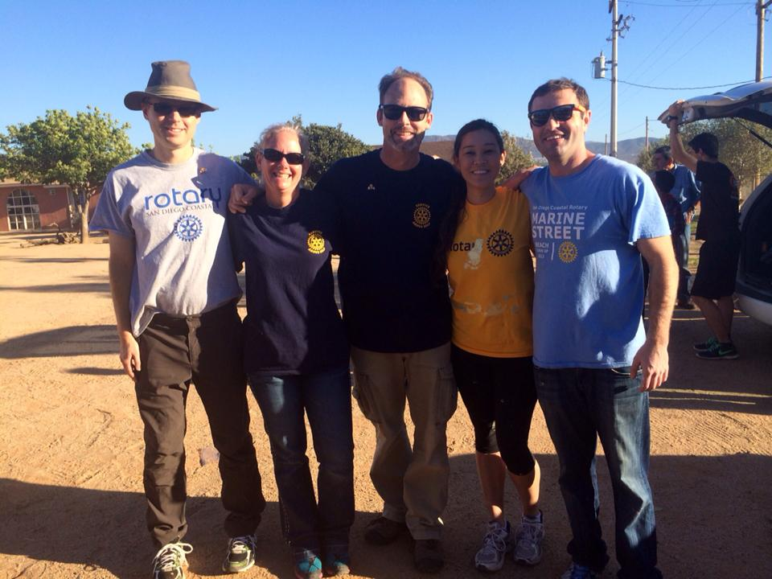
Welcome!
San Diego Coastal Rotary Club is excited to host a weekend International Service Project. Members still would like to see these things in a service project:
Members would like more international service opportunities
Taking time off can be rough, so a weekend trip would be ideal
The desire to have fun! Although service is a must, the group would like to incorporate a fun activity into the weekend
We’re excited to announce and provide additional details for our weekend trip to Mexico. In this packet, you’ll find details about the project, details about the orphanage, an itinerary, expenses and next steps to sign up. We hope you can join us!

Slide 3
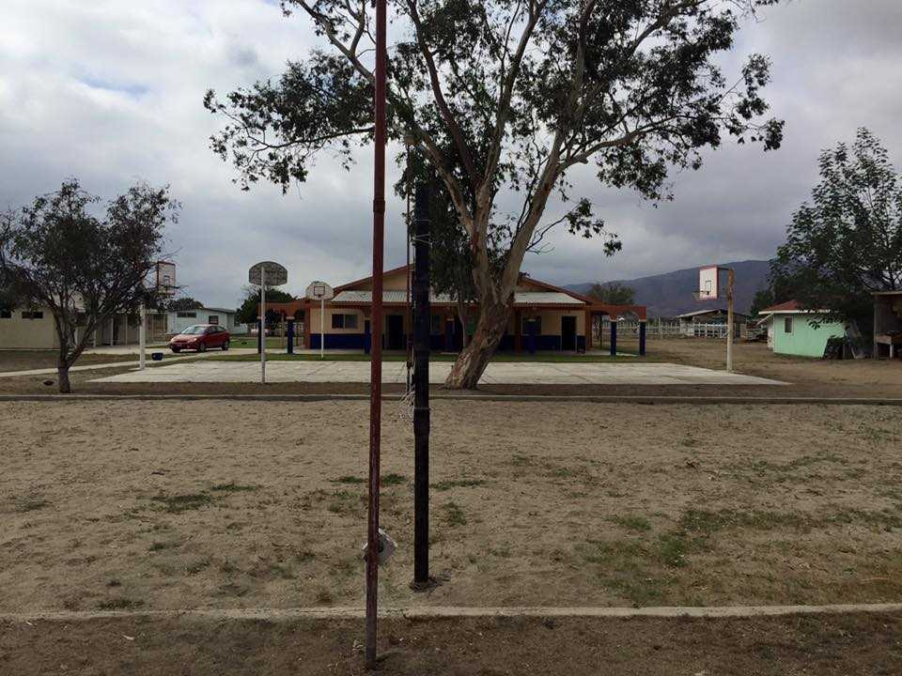
About Corazon de Vida
Founded in 1994, Corazon de Vida is a US-based nonprofit organization supporting Baja orphanages. They provide children in dire need the necessities of shelter, food, clothing, education, and healthcare – as well as hope, compassion, and love.
We’ve had a wonderful partnership with Corazon de Vida over the years, with our Rotarians going on
a number of trips to the orphanages supported by Corazon de Vida.
We’d like to continue the tradition while offering our Rotarians the chance to volunteer across the border in Mexico.

Slide 4
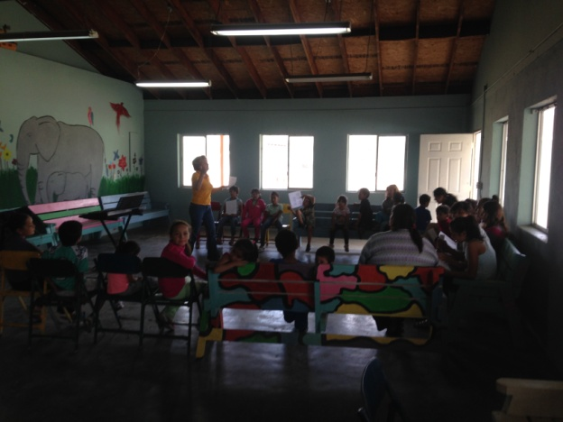
About Casa de Los Niños
Husband and wife directors Jorge and Ely grew up at this same orphanage. They went to university for their degrees, got married, have 3 kids, and returned to be directors about 2 years ago.
Home has been in existence for about 40 years
Currently about 75 kids, including 12 special needs young adults and 20 staff
Has greenhouse that produces vegetables, livestock
All children in school, about 10 graduating from primary & secondary this month
Did you Know?
Mexico does not have a foster care system to support children in need due to neglect, abuse, or abandonment
Unlike in the United States, there is no welfare system for single parents who are unable to adequately provide for their child
There are approximately 50 orphanages in Baja California, Mexico

Slide 5
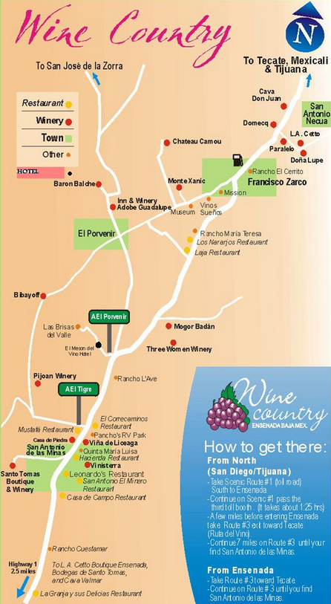
About the Area Valle de Guadalupe
Less than two hours from San Diego, Valle de Guadalupe has quickly become known as an up and coming area for wine
Estimated population of 2,664 people
Founded in 1834 by Dominican missionary Felix Caballero and was the last mission established in “California”
Since the 1900’s, the Valley de Guadalupe is the home of the association of winemakers holds the Grape Harvest Fiestas

Slide 6
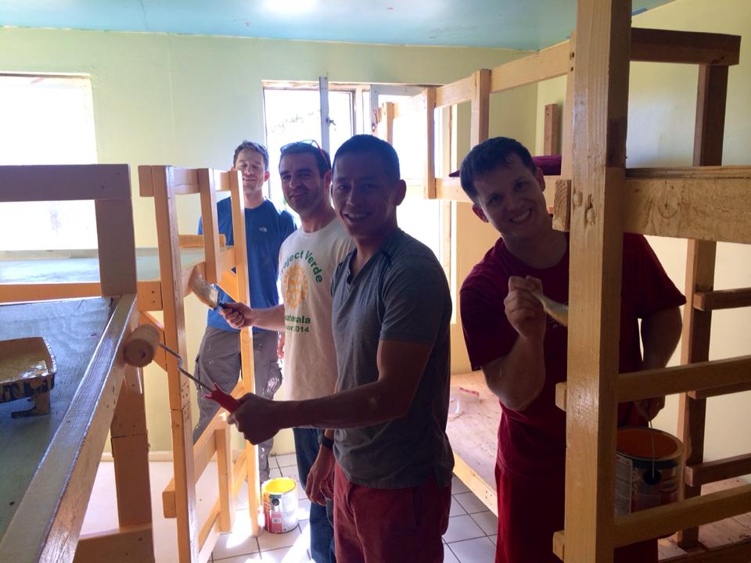
What Will We Be Doing?
George Perez, Director of Operations with Corazon de Vida has been working with Casa de los Niños to identify projects for our group that will include:
Upgrade and improve the living conditions of the existing and newly remodeled dorms.
Painting and remodeling of the outdoor areas of the new and existing dorms
Serving lunch to the kids and the orphanage staff
Arts & crafts and spending some quality time with the children as they do not have much 1x1 time with adult figures

Slide 7
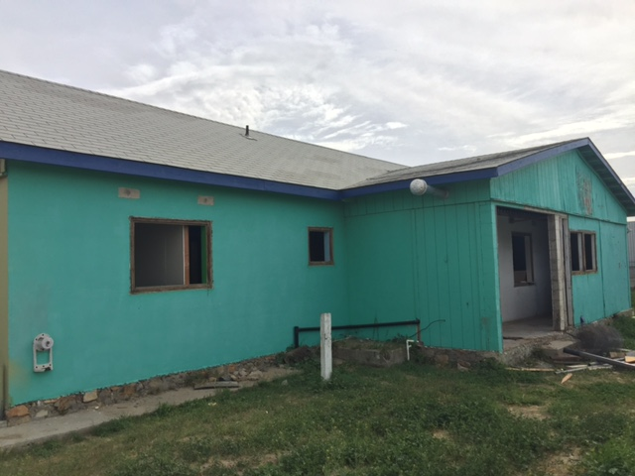
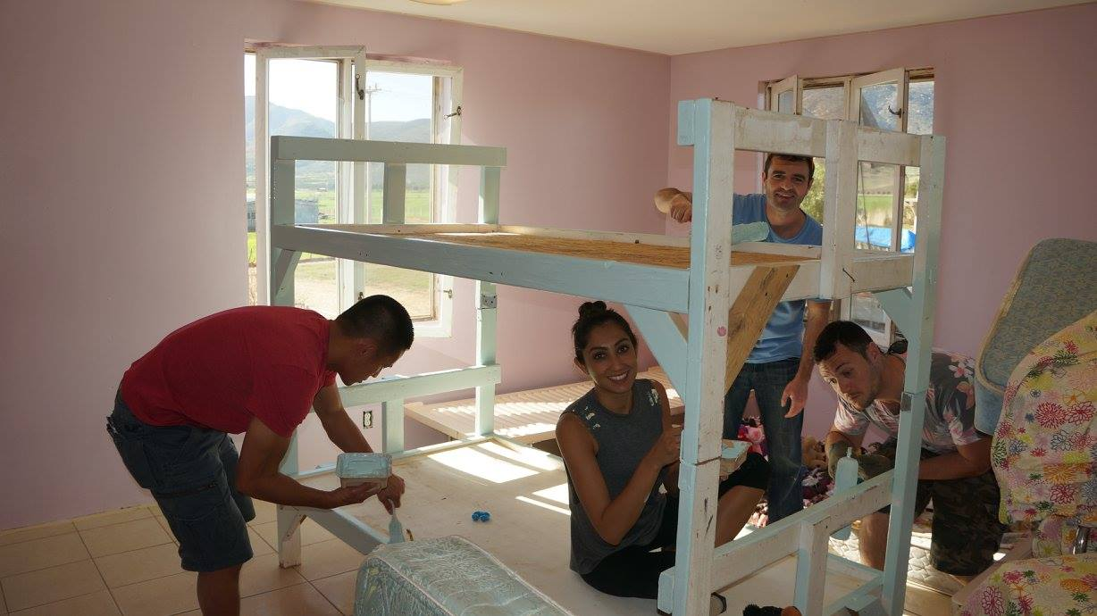
Remodeled dorm Projects
Exterior of dorm
The exterior is need of improvements including beautification, painting and landscaping.
Removing the sharp bush and replacing with more friendly plants.
Fixing the clothes line area, which is used for all of the kids at the home.

Slide 8
Existing Dorm Projects
Fixing the dry wall where there is water damage
Painting damaged areas

Slide 9
Existing Dorm Projects
Installing mirrors so the kids can use the bathrooms adequately.
Fixing closets to provide adequate storage for the kids housed in the dorm.

Slide 10
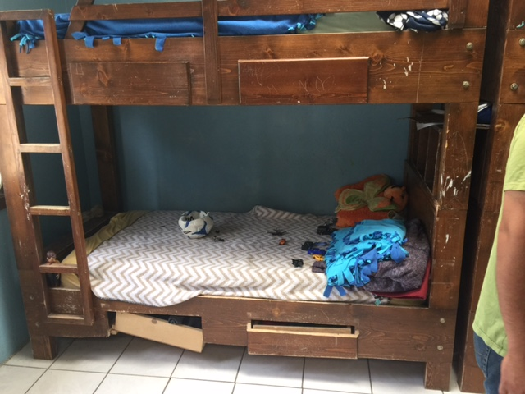
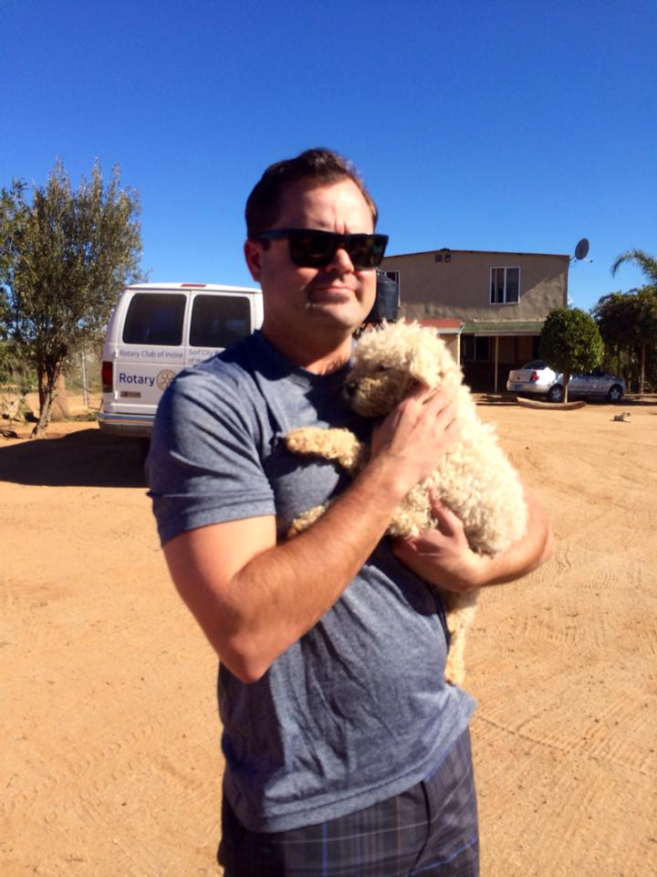
Bedroom Projects
Sleeping Areas
Installing curtains :Many of the curtain rods have broken or have fallen off to ensure that the kids can have they privacy they need.
Repairing the bunk beds and fixing the drawers that hold on to the items for the kids.

Slide 11
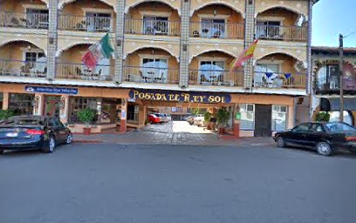
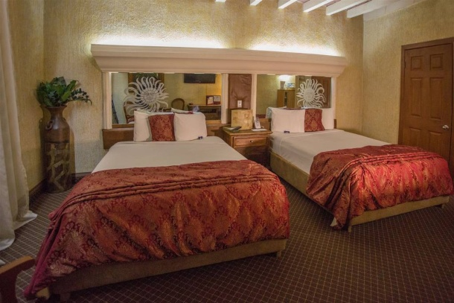
Where Will We Be Staying?
Hotel Posada El Rey Sol
Hotel amenities include internet, pool and hot tub
Single rooms and double rooms, will need to share beds, 2-4 in a room
In center of Ensenada near night life activities
Hotel gives a Medical Lane Pass for the Border to make crossing faster
/
Blancarte 130, Zona Centro, 22800 Ensenada, BC, Mexico
posadaelreysol.com
+52 646 178 1601

Slide 12
How Much Will It Cost?
We are trying to keep the trip affordable to fit within everyone’s budget TOTAL COST - $150
Includes lodging, transportation and some meals.
The hotel includes breakfast in the morning of Sunday, in which there are two or three choices. If you would like something else other than that it will cost extra.
Meals at the orphanage will be included, last year we had a taco truck guy show up and it was great!
Budget an extra $ 25-30 for meals Saturday night dinner and possibly more for alcoholic beverages.

Slide 13
Itinerary Saturday, August 27th
We’ll plan to meet at the Otay Mesa IHOP on Aug 27. Vehicles can be parked overnight in secure lot for $8 per day.
Saturday
8:00 - Meet at IHOP, load carpool vehicles, depart by 8:30
10:30 - Arrive Casa de los Niños. Service project, lunch, fun with kids.
5:00 - Depart orphanage, hotel check in, eat at local restaurant. Enjoy the night life of downtown Ensenada.

Slide 14
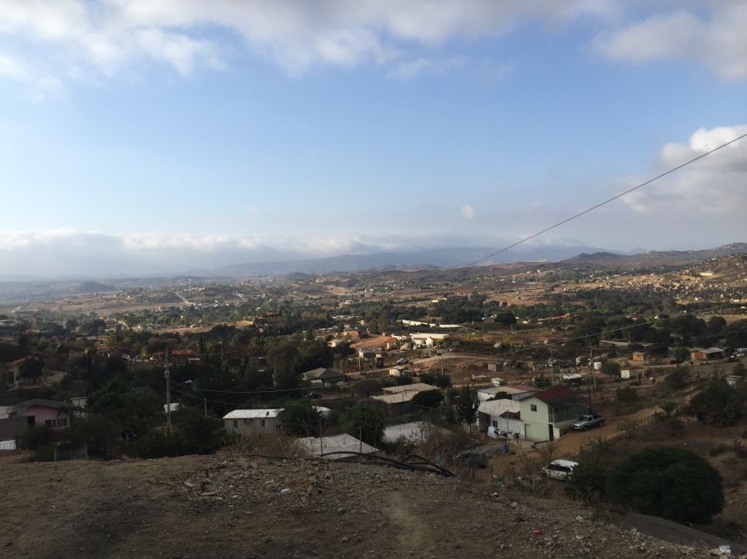
Itinerary Sunday, August 28th
Sunday
8:30 - Breakfast at hotel
10:00 - Return to Casa de los Niños to complete work project
1:00 -Wine Tasting or other activities
3:30 - Depart Valle de Guadalupe
5:30 - Arrive Otay Mesa border crossing. People walk to cars in lot via pedestrian lane, carpool drivers to drive across

Slide 15
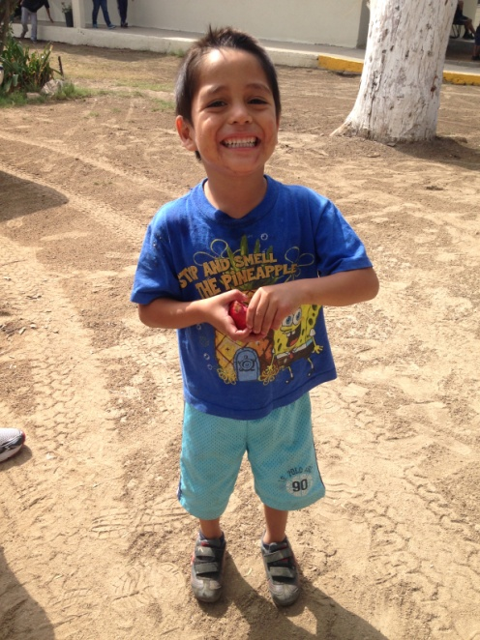
Can’t Come But Want to Contribute?
Casa de los Niños is in need of the following supplies:
Toilet Paper
Detergent
Bleach
Dish Soaps
Mops
Brooms
Large Trash Bags
Diapers (Sizes 4,5 and 6)
Breakfast Bars
Twin sheets
Blankets
Juice Boxes
New socks and underwear
Feminine Products
Baby Wipes
Batteries
Plastic Bowls, Cups and Plates
Metal/Reusable Eating utensils
Optional items to improve the daily life of the children are also always appreciated:
Toys/Games
Hair products (Shampoo, hair ties, brushes)
Clothing
Spots Equipment (Soccer balls)
Spanish DVDs
Spanish Books

Slide 16
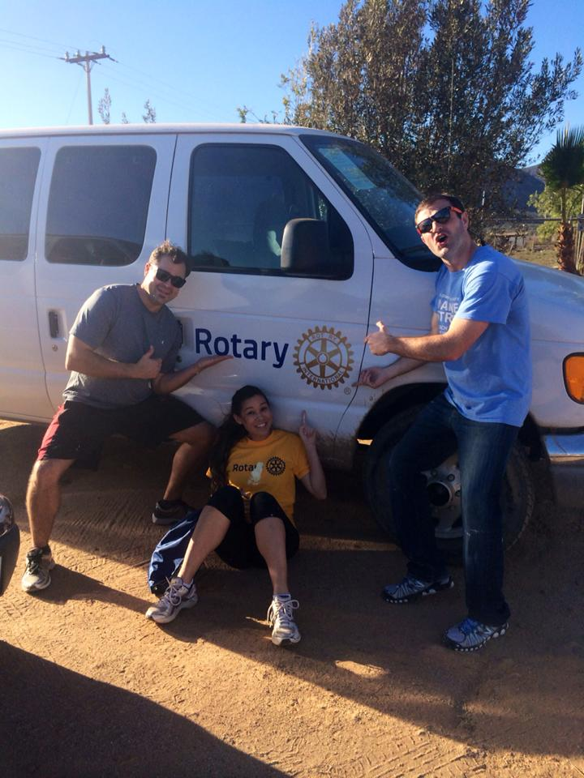
Don’t Forget…
Everyone needs a valid passport
To pack warm clothing. It can get cool even in summer, so make sure to pack a sweatshirt or light jacket
Closed toe shoes. We’ll be doing some hands-on service project and we’ll want to be as safe as possible
Clothing you don’t mind getting dirty. We’ll have a number of projects on hand if you want to “stay clean” but are planning to paint and build benches, so bring clothes that you can work in
Hope you’ll be able to join us for this fun-filled weekend in Baja!

Slide 17
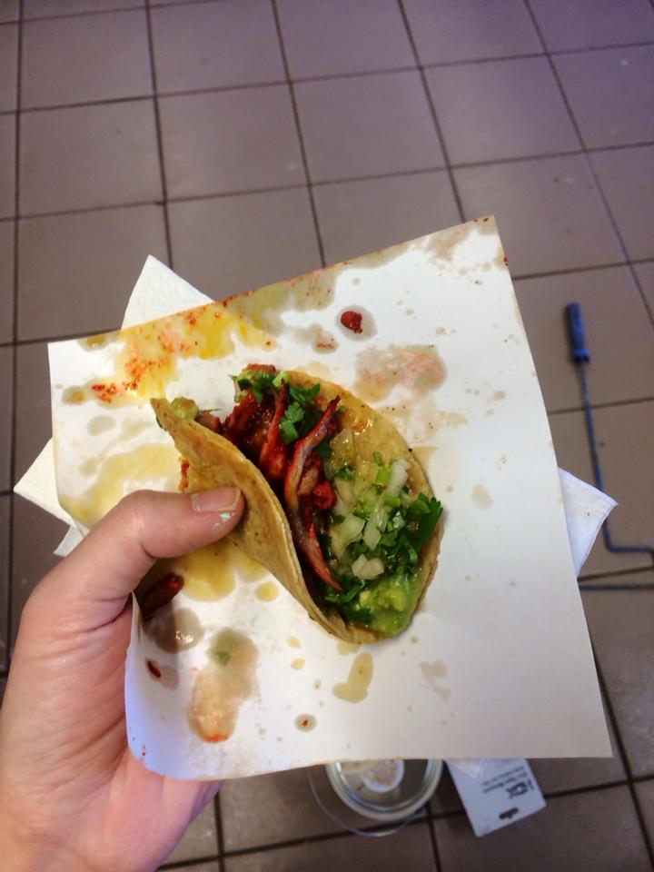
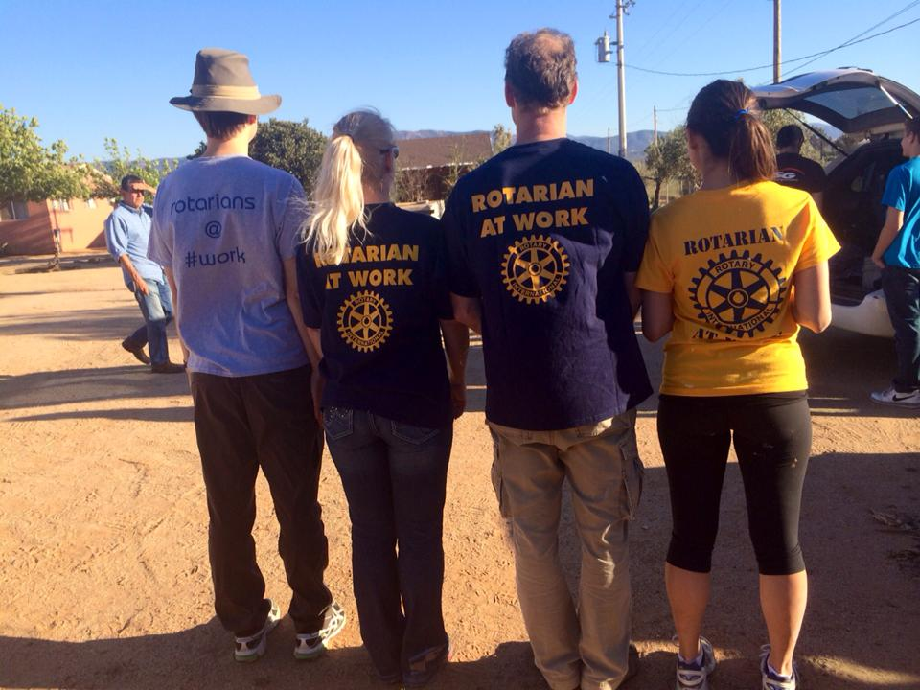

Slide 18
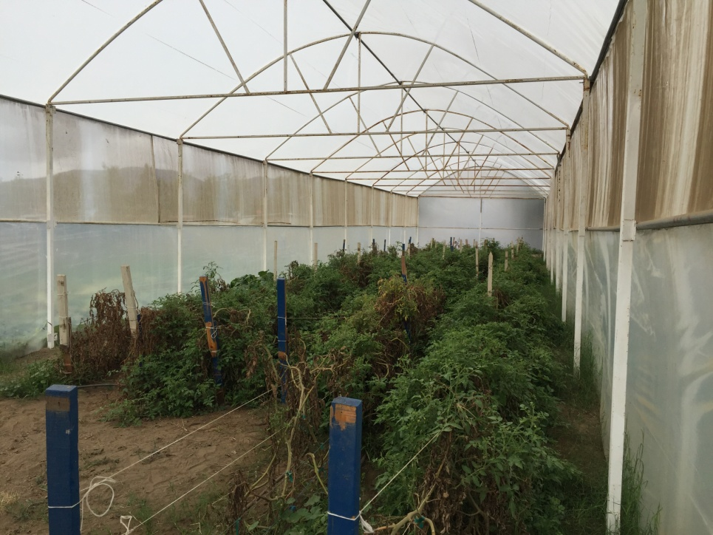

Slide 19
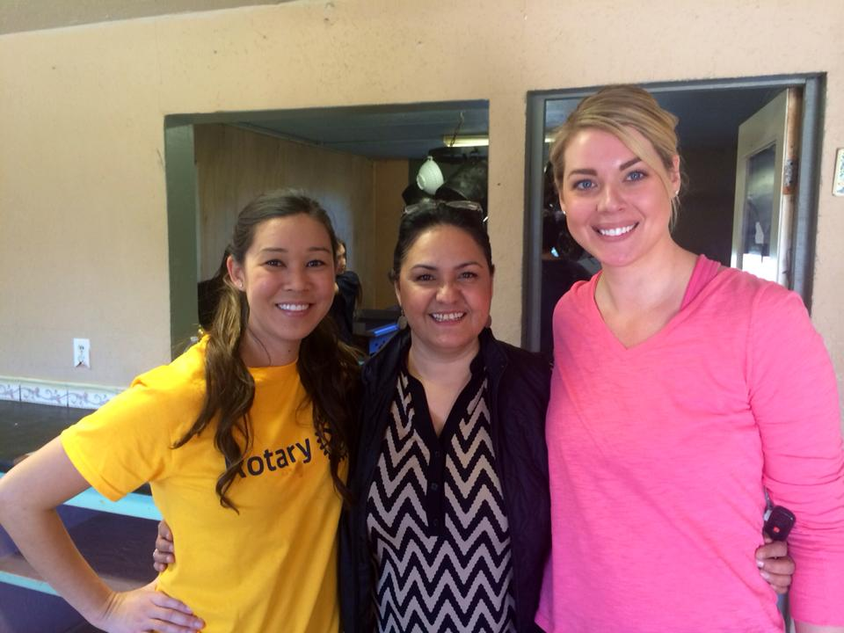

Slide 20
