Slide 1
POETS Presidents & Officers Elect Training Seminar 2022-2023 Whatever your interactions within your Clubs – following this training – please bear in mind., what has been discuss and planned for at this POETS Session only takes effect on 1 July 2022.

Slide 2
Session 2: Learning Objectives
Getting to Know the District Support Structure.
Understand the RI Brand and how it should be used.
How to Grow….
The importance of The Rotary Foundation and how your club benefits.
Notes:
Again – let’s recap

Slide 3
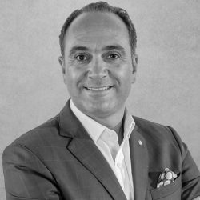
The Rotary Brand and its importance
PDG Sergio Almeida (District 1970) Portugal
Regional Public Image Co-Ordinator
Portugal & Spain 2021 -2024
RI International Assembly training
Leader 2022

Slide 4
The Importance of Rotary PI Video - PI with Sergio Almeida
Click Here for
Video

