Slide 1

POETS
Presidents & Officers Elect Training Seminar 2022-2023
Whatever your interactions within your Clubs – following this training – please bear in mind., what has been discuss and planned for at this POETS Session only takes effect on 1 July 2022.

Slide 2
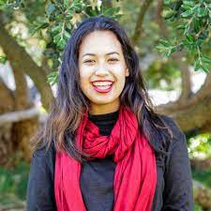
Making an Impact with Rotaract
Waterfront Rotaract Club
Emily O’Ryan

Slide 3


Slide 4
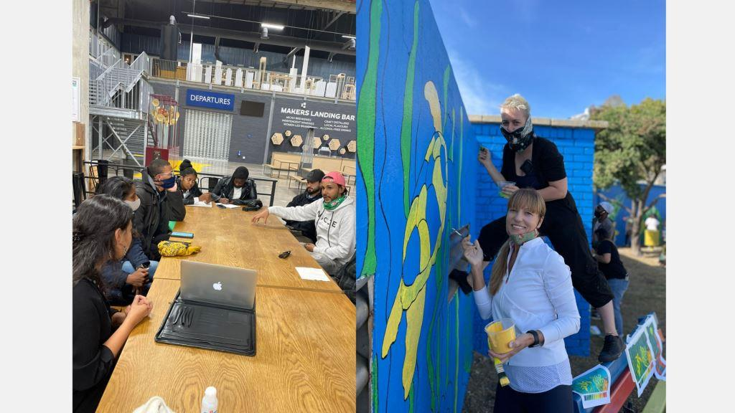

Slide 5
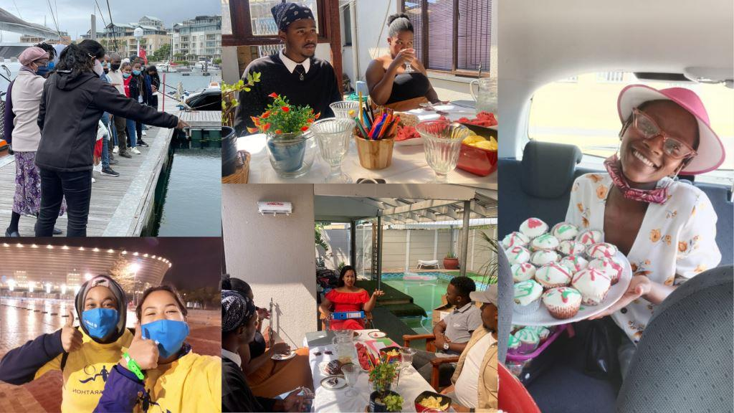

Slide 6


Slide 7


Slide 8


Slide 9
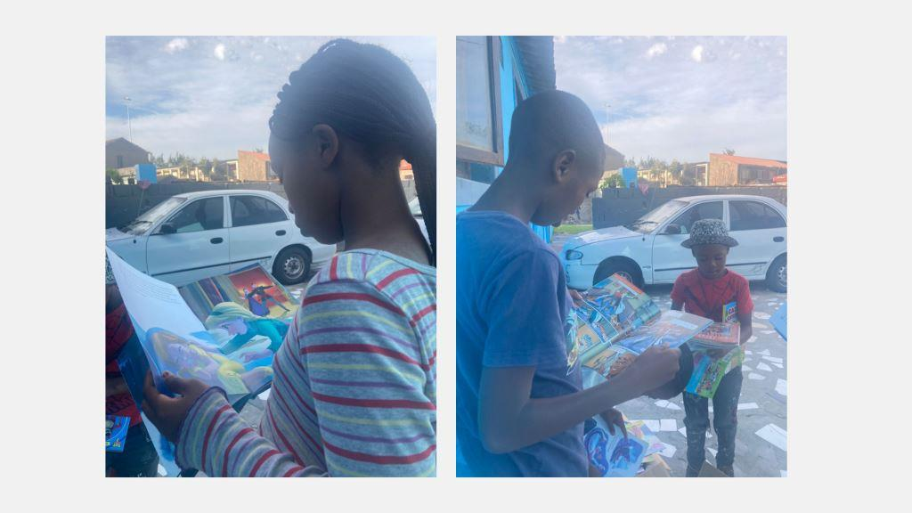

Slide 10
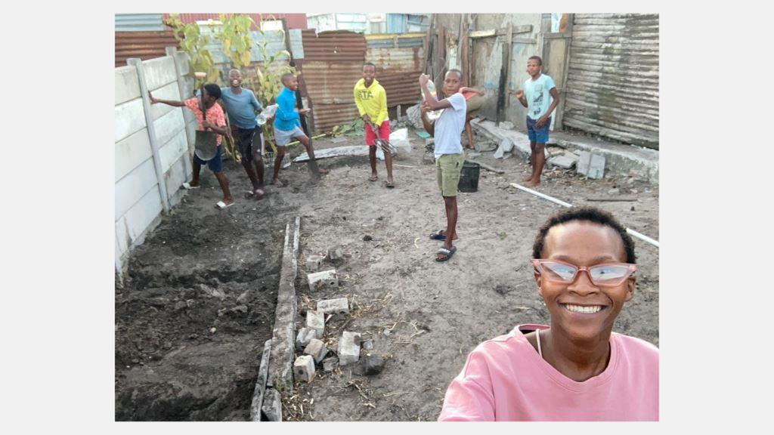

Slide 11
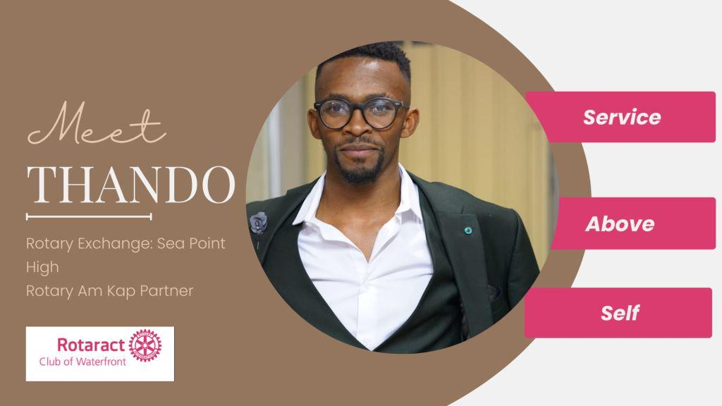

Slide 12


Slide 13
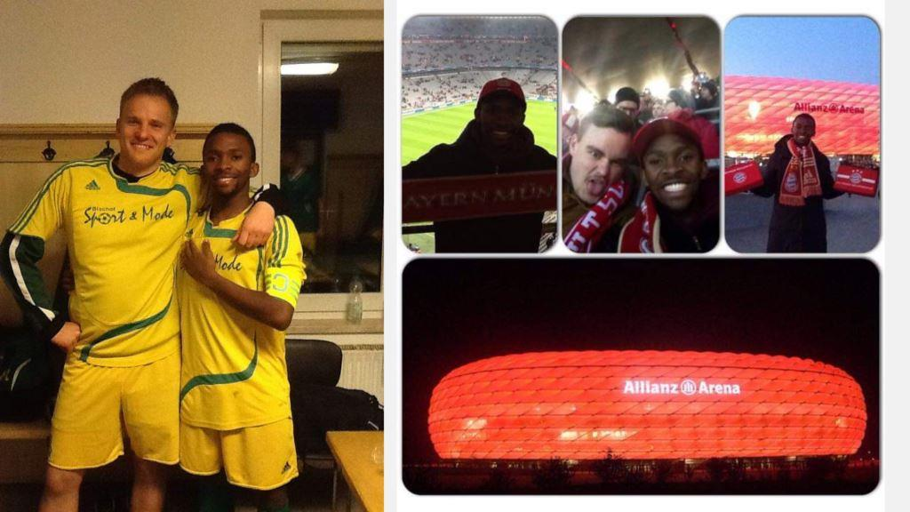

Slide 14
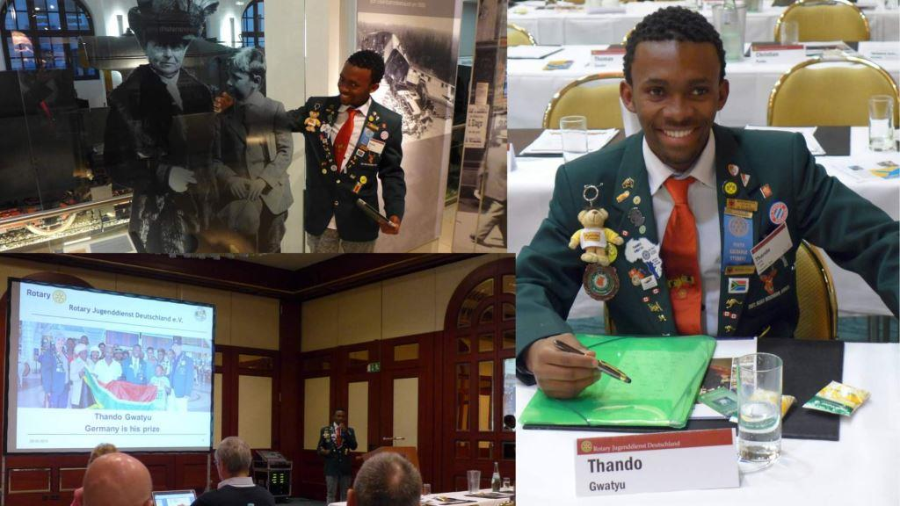

Slide 15
