Slide 1
POETS Presidents & Officers Elect Training Seminar 2022-2023 Whatever your interactions within your Clubs – following this training – please bear in mind., what has been discuss and planned for at this POETS Session only takes effect on 1 July 2022.

Slide 2
Session 2: Learning Objectives
Getting to Know the District Support Structure.
Understand the RI Brand and how it should be used.
How to Grow….
The importance of The Rotary Foundation and how your Club benefits.
Notes:
Again – let’s recap

Slide 3
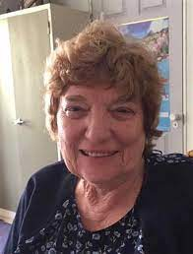
The Rotary Foundation
Helene Visser

Slide 4
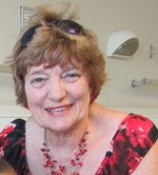
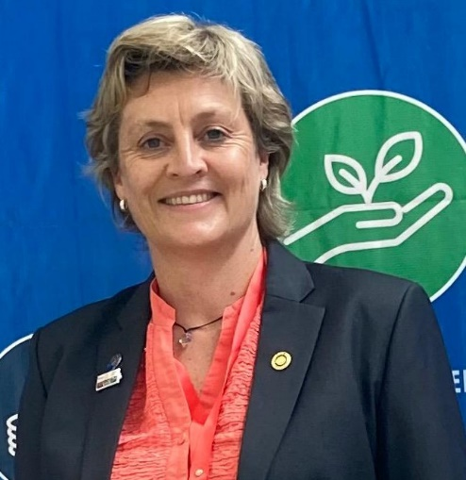
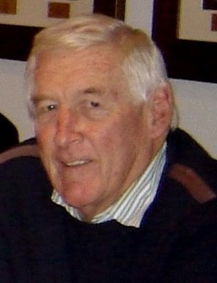
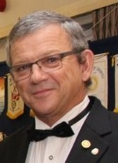
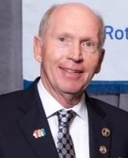
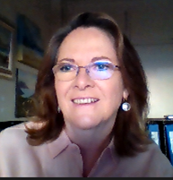
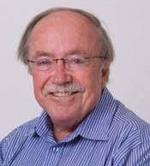
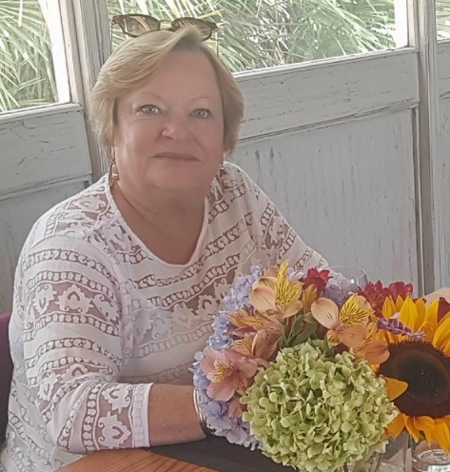
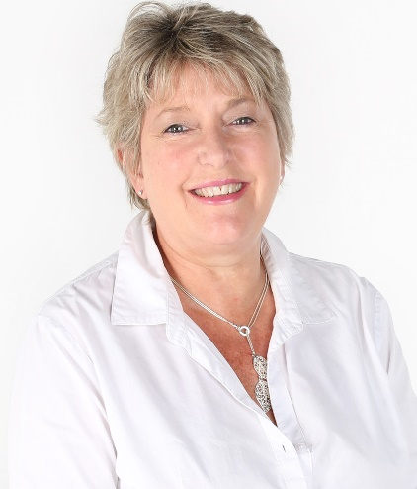
FOUNDATION TEAM – POETS – 26th March 2022
Helène Visser – District Rotary Foundation Chair
Peter Hugo - District
Grants Co-ordinator
Casper Kruger – Annual & Permanent Fund Contributions
DGE Tracey Wilson
Carl– Heinz Duisberg – International & ICC
Janey Ball – Polio Plus
Mike Walwyn –
Peace Scholarships
Joke Young –
Incoming Scholarships
Monique Stuart-Fox – (VTT) Vocational Training Teams

Slide 5
The Rotary Foundation
Is the lifeline to all successful Global Grants & District Grants
The Rotary Foundation is totally dependent on financial gifts from Rotarians and Rotary Clubs, to be able to help finance Global Grants and District Grants. Each year our District Governor invites Rotary Clubs to ‘give’ to the Rotary Foundation as the funds received by the Annual Fund from a District, is invested for 3 years so that 50% (minus a 5% admin fee), of the Capital raised by the Clubs, comes back to the Rotary District as DDF (District Designated Funds) and the other half goes to the World Fund. All Rotary Clubs in our District may apply for a Global Grant to fund their favourite project and may request a contribution of $2,500 from District towards their project. It is important that each club makes a donation every year, no matter how small!!
To date (23rd March 2022), 19 Rotary Clubs in our District raised $22,511 (equating R341,277) & 9 Rotary Clubs raised $1,825-98 (equating R27,682) for Polio Plus.
On the 23rd March I celebrated my 75th birthday. I invited a few friends to my home to celebrate with me and asked that they rather give a donation for the Rotary Foundation instead of buying me a present. My friends have been so very generous and we were able to raise R45,000 for the Rotary Foundation. Blouberg RC & D9350 will both be acknowledged. I invite all Rotarians to do something similar?
DRFC – Helène Visser – 26th March 2022

Slide 6
GLOBAL GRANTS
We invite the Rotary Club President, the Rotary club Foundation Chair and the club members, to log onto the MyRotary Learning Centre and to complete the Rotary Foundation training for Clubs.
Each year, every Rotary Club has to sign a MOU (Memorandum of Understanding) and one or more club members have to attend The Rotary Foundation Training Seminar, which will then qualify the respective Rotary Club to be able to apply for a Global Grant. (The DG, the Foundation Chair and the DGE have to do the on-line Foundation training course so as to qualify the District).
All Global Grant applications have to align with one of the 7 Areas of Focus.
Each Global Grant application amount has to be for a minimum of US$30,000.
A maximum of $2500 DDF funds may be requested from D9350 for each Global Grant application.
Please apply for DDF in writing to Peter Hugo (peterplace03@gmail.com) at the District office, with an explanation of your project as well as the value thereof. Your application will be submitted to a committee for final approval.
Once your Global Grant has been approved, the Rotary Club has a full year to complete the project and to send a report to RI. If incomplete, please do a progress report. Please do this timeously – at least 2 weeks before due date!
If not done, then NO other GG applications for both Districts involved, will be approved.
A final report has to be submitted within 2 months after completion of the Global Grant.
DRFC – Helène Visser – 26th March 2022

Slide 7
DISTRICT GRANTS
Peter Hugo will send out the District Grant applications during April 2022.
Completed applications to be submitted to Peter by the 31st May 2022 together with quotes.
No application will be approved if there is no involvement from the Rotary Club and its members.
Rotaract Clubs may also apply. This has to be done under the supervision of the sponsor Rotary Club.
Club tax affairs must be in order for both the Rotary Club and the Rotaract Club!
If you are not registered with SARS, please contact Tony Butcher (District Treasurer) for assistance.
Once registered with SARS, also register as a PBO.
Preference will be given to District Grant applications from Rotary Clubs who contributed to the Foundation.
The Maximum amount allowed per District Grant application is R20,000.
The District Grant Report, regardless whether the project has been completed or not, has to be submitted to Peter Hugo by 31st March, 2023 as he has to report to the Rotary Foundation before a new application can be submitted for the following year.
DRFC – Helène Visser – 26th March 2022

Slide 8
ANNUAL FUNDS & POLIO PLUS Contributions
We urgently need contributions from each and every Rotary Club to raise our annual fund.
Without the funding paid to the Rotary Foundation, there will be NO funds available for District or Global Grants.
Janey Ball is the Polio Plus Chair for D9350. She created a fundraising platform and invited all Rotary Clubs to get involved with the ‘Raise for Rotary’ campaign.
Contact her on janey@iafrica.com
For assistance with Global Grants or District Grants, please contact me on helene@erasteer.co.za or call me on 0825749257. Please remember to inform the District office if you changed your e-mail address as you might have a problem to get access into MyRotary. We are available to help.
Thank you

Slide 9
Video - With Rotary you CAN
Click Here for
Video

