Slide 1
POETS Presidents & Officers Elect Training Seminar 2022-2023 Whatever your interactions within your Clubs – following this training – please bear in mind., what has been discuss and planned for at this POETS Session only takes effect on 1 July 2022.

Slide 2
Session 2: Learning Objectives
Getting to Know the District Support Structure.
Understand the RI Brand and how it should be used.
How to Grow….
The importance of The Rotary Foundation and how your club benefits.
Notes:
Again – let’s recap

Slide 3
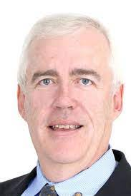
Membership
David Holtzhausen

Slide 4
Video - Rotary ANYTOWN
Click Here for
Video

Slide 5
Membership Support
and Growth Plan
2022-2023 and beyond

Slide 6
Membership Plan
New Clubs – regional task teams
Training – empower all levels of leadership
Revive Clubs – support where needed
Expand Clubs - motivate all Clubs to recognize opportunities

Slide 7
Training
Webinars on
Welcome to Rotary
New member intro
Fireside chats
Motivating your club
How to invite
Details and dates to follow

