Slide 1

POETS
Presidents & Officers Elect Training Seminar 2022-2023
Whatever your interactions within your Clubs – following this training – please bear in mind., what has been discuss and planned for at this POETS Session only takes effect on 1 July 2022.

Slide 2
Session 2: Learning Objectives
Getting to Know the District Support Structure.
Understand the RI Brand and how it should be used.
How to Grow….
The importance of The Rotary Foundation and how your club benefits.
Notes:
Again – let’s recap

Slide 3
Meet the District Support Team

Slide 4
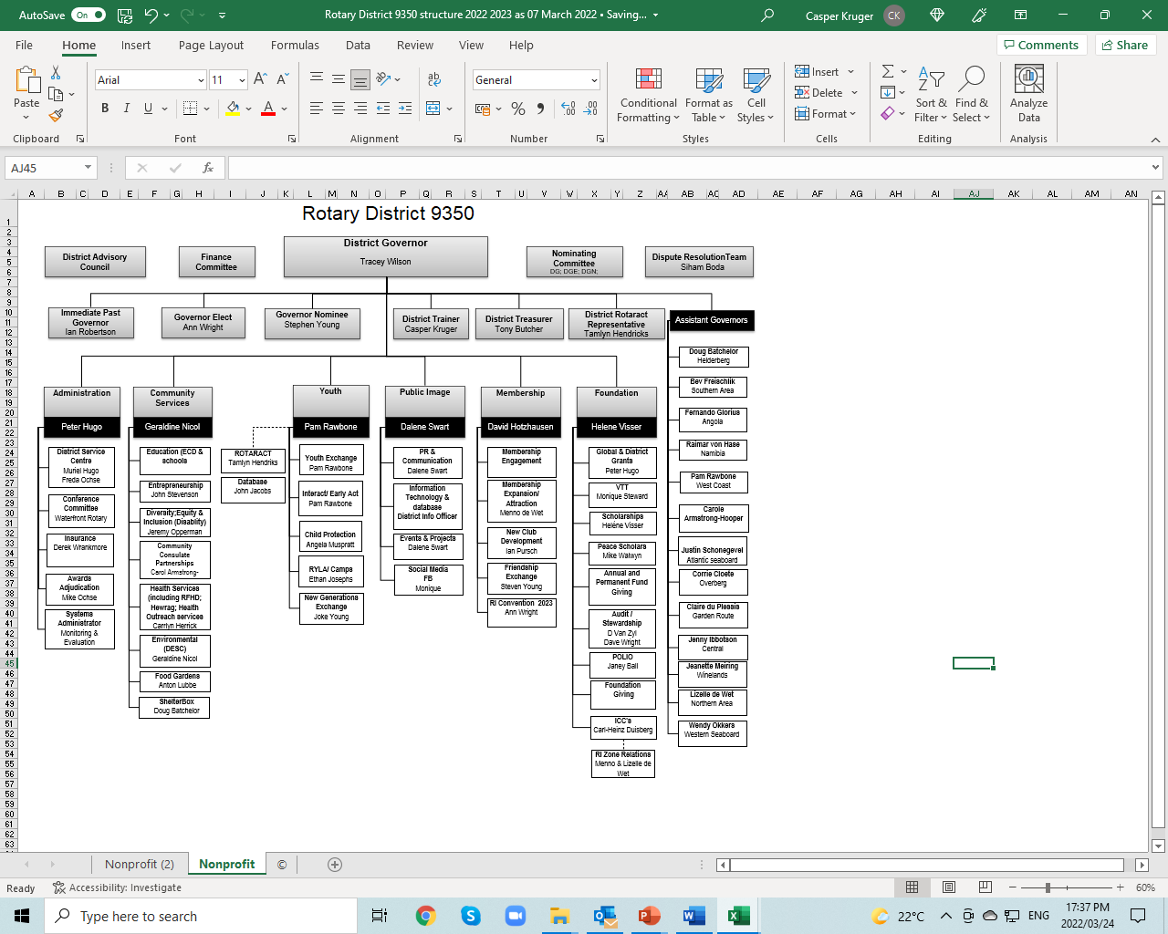

Slide 5
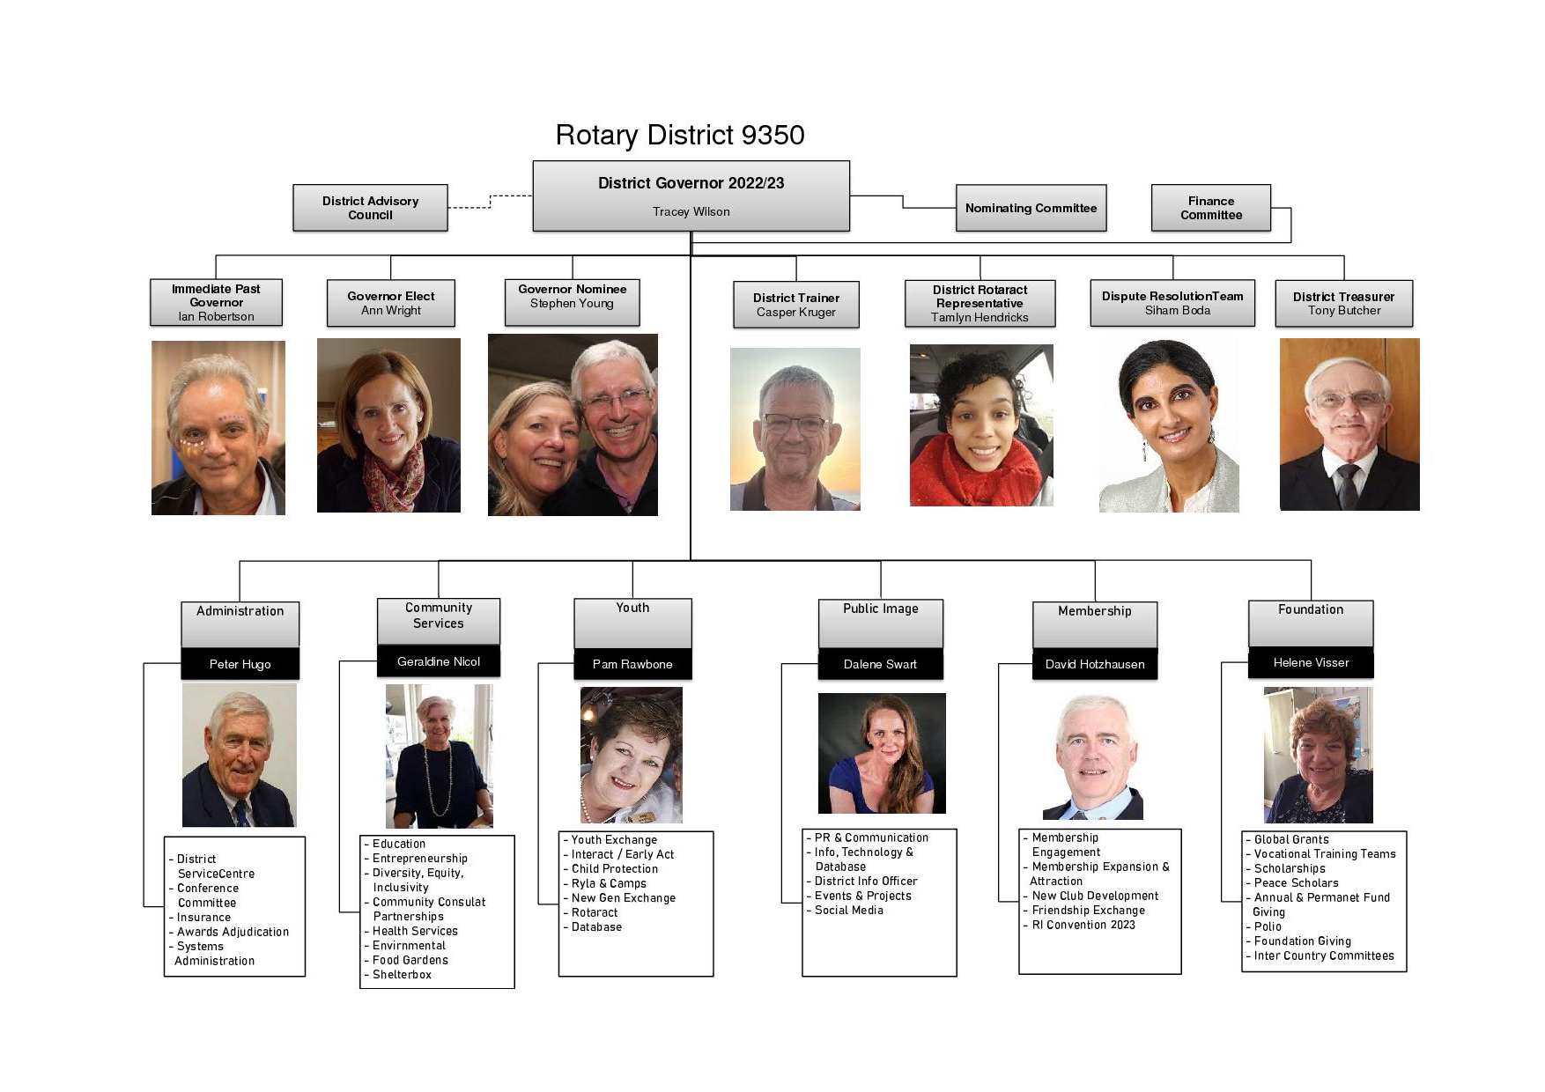

Slide 6
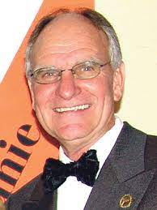
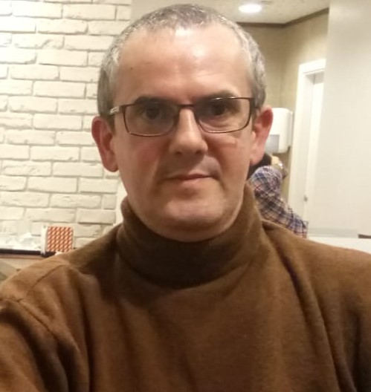
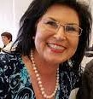
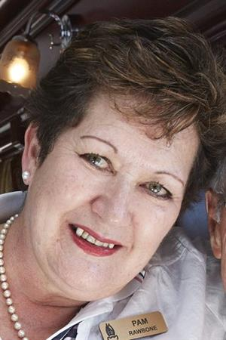
Meet the Assistant Governor team…
RAIMAR VON HASE
FERNADO GLORIAS
LIZELLE DE WET
PAM RAWBONE
NAMIBIA
Swakopmund
Walvis Bay
Windhoek
Kleinmond Windhoek Valley
Auas
Luderitz
Otjiwarongo
ANGOLA
Luanda
Luanda Sul
Lobito
NORTHERN AREA
Goodwood
Oostenberg
Bellville
Tygerberg
Durbanville
WEST COAST
Atlantis
Melkbos
Upington
Riebeek Valley (new)
Langebaan

Slide 7
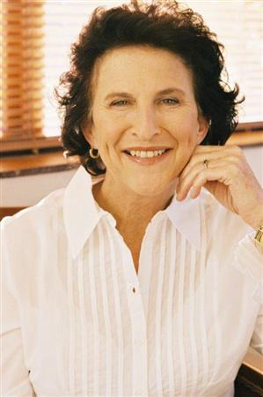
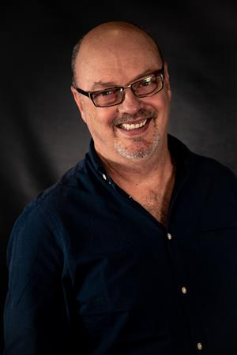
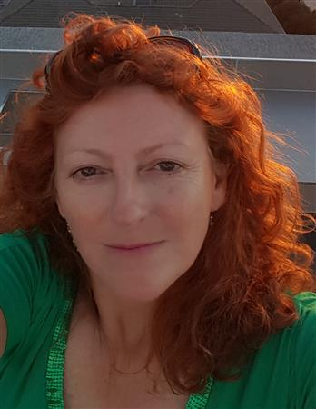
Meet the Assistant Governor team…
JENNY IBOTTSON
DOUG BATCHELOR
CAROL ARMSTRONG HOOPER
CENTRAL
Claremont
Newlands
Pinelands
Kirstenbosch
Kromboom
HELDERBERG
Helderberg
Helderberg Sunrise
Strand
Somerset West
Kleinmond
CITY CENTRE
Noon Gun
Cape Town
Signal Hill

Slide 8
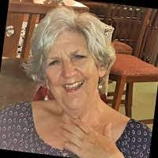
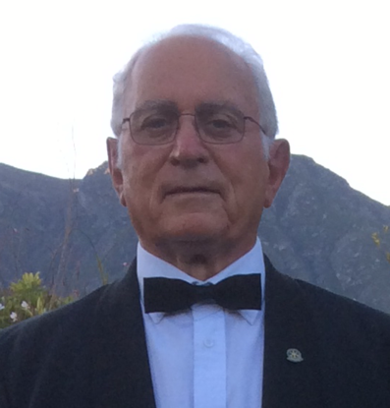
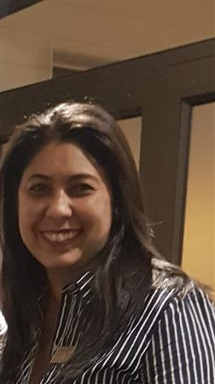
Meet the Assistant Governor team…
BEV FRIESLICH
CORRIE CLOETE
WENDY OKKERS
SOUTHERN AREA
Hout Bay
Wynberg
Constantia
Cape of Good Hope
OVERBERG
Hermanus
Swellendam
Stanford
Breede River Winelands
Greyton (satellite)
WESTERN SEABOARD
Century City
E-Club Greater CT
Blouberg
Table Bay

Slide 9
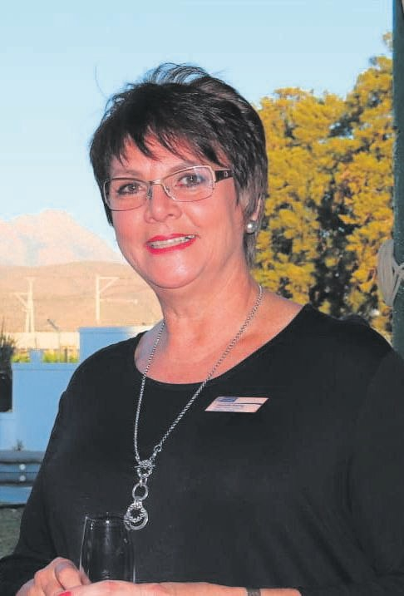
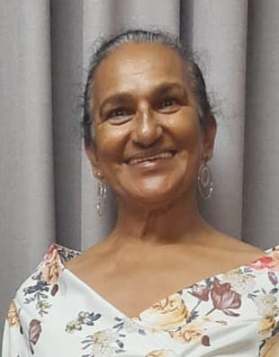
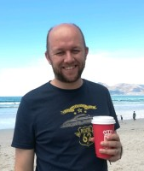
Meet the Assistant Governor team…
JEANETTE MEIRING
CLAIRE DU PLESSIS
JUSTIN SCHONEGEVEL
GARDEN ROUTE
Beaufort west
Mossel Bay
Oudtshoorn
George
Knysna
Plettenberg Bay
ATLANTIC SEABOARD
Sea Point
Waterfront
Am Kap
Cap de Tempetes
CAPE WINELANDS
Paarl
Franshhoek / Drakenstein Valley
Worcester
Stellenbosch

