Slide 1
POETS Presidents & Officers Elect Training Seminar 2022-2023 Whatever your interactions within your Clubs – following this training – please bear in mind., what has been discuss and planned for at this POETS Session only takes effect on 1 July 2022.

Slide 2
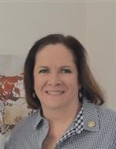
POPI ACT BY JANEY BALL

Slide 3
P is for … … …

Slide 4
Polyunsaturated
Parallelogram
Percussionist
Pachyderm
Padded Cell

Slide 5
perplexed personal president perpetual progressive permission porcupine pie personable practical protect panic perfect possibly pertinent paia perhaps professor privacy puzzle pyrotechnic public project process puff adder prophet protect petrol picket protest prison politician pofadder

Slide 6
Protection
Of
Personal
Information
Act

Slide 7
perplexed PERSONAL president perpetual progressive porcupine pie PERMISSION personable PRACTICAL panic perfect possibly pertinent paia perhaps PROTECT professor PRIVACY puzzle pyrotechnic public project puff adder prophet PROCESS petrol picket protest prison politician pofadder

Slide 8
PROTECT

Slide 9
PERSONAL

Slide 10
PERMISSION

Slide 11
PRACTICABLE

Slide 12
PROCESS

Slide 13
PRIVACY

Slide 14
PERSONAL
PERMISSION
PRACTICABLE
PROTECT
PROCESS
PRIVACY

Slide 15
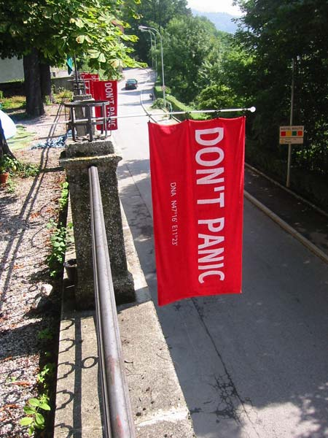

Slide 16
RESOURCES
District Assembly (23rd April)
Kevin Hoole, from Michalsons
The Act
https://popia.co.za/
Information Regulator
https://www.justice.gov.za/inforeg/portal.html
Michalsons Popia Plain Language Guide
https://prezi.com/i/view/yWrmi9BT1cEBiW59F8EY

