Slide 1

POETS
Presidents & Officers Elect Training Seminar 2022-2023
Whatever your interactions within your Clubs – following this training – please bear in mind., what has been discuss and planned for at this POETS Session only takes effect on 1 July 2022.

Slide 2

Club Runner and My Rotary
John Jacobs (JJ)

Slide 3


District 9350 - POETS 2022-2023
Managing Your Club
with
ClubRunner

Slide 4

District 9350 - POETS 2022-2023
Managing Your Club with ClubRunner
OneRotary
Initiative
ClubRunner
Server
Integration
“My Rotary”
Database
Front of House
Back of House
Home Page
Members Area

Slide 5
District 9350 - POETS 2022-2023
Managing Your Club with ClubRunner
Public
Rotarians
Public Access
Public Communication
District Contacts
Club Contacts
Club Meetings & Times
District Events
District Calendar Posting
Project Exposure Posting
Member Information
Member Search
Club Dashboard
Smart Phone Directory
Photo Albums
District Documents
District Bulletin
District Training Links

Slide 6
District 9350 - POETS 2022-2023
Managing Your Club with ClubRunner
● website – www.rotary9350.co.za
● Login to Member Area
● Register

Slide 7
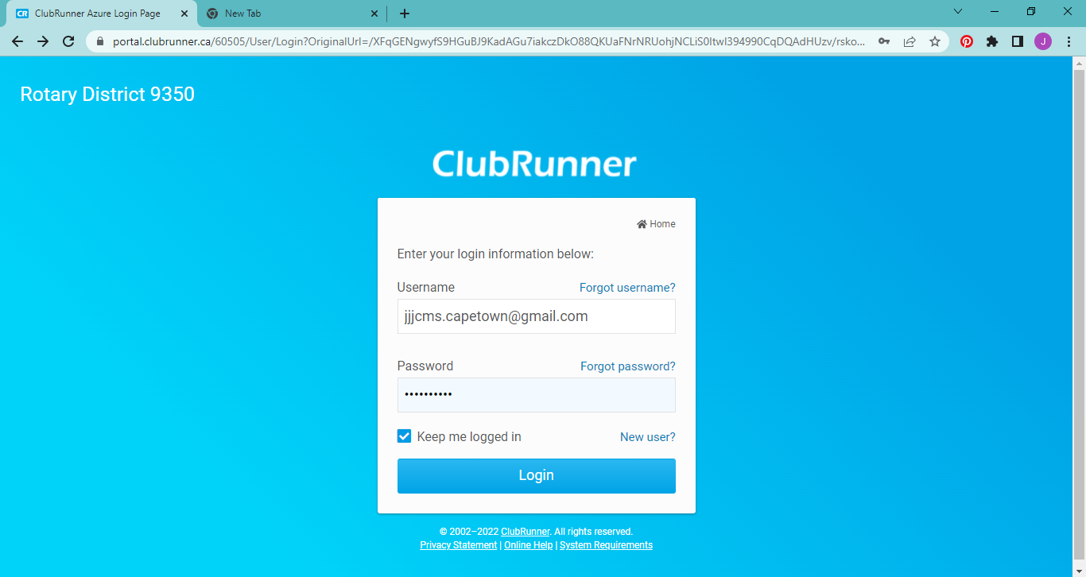
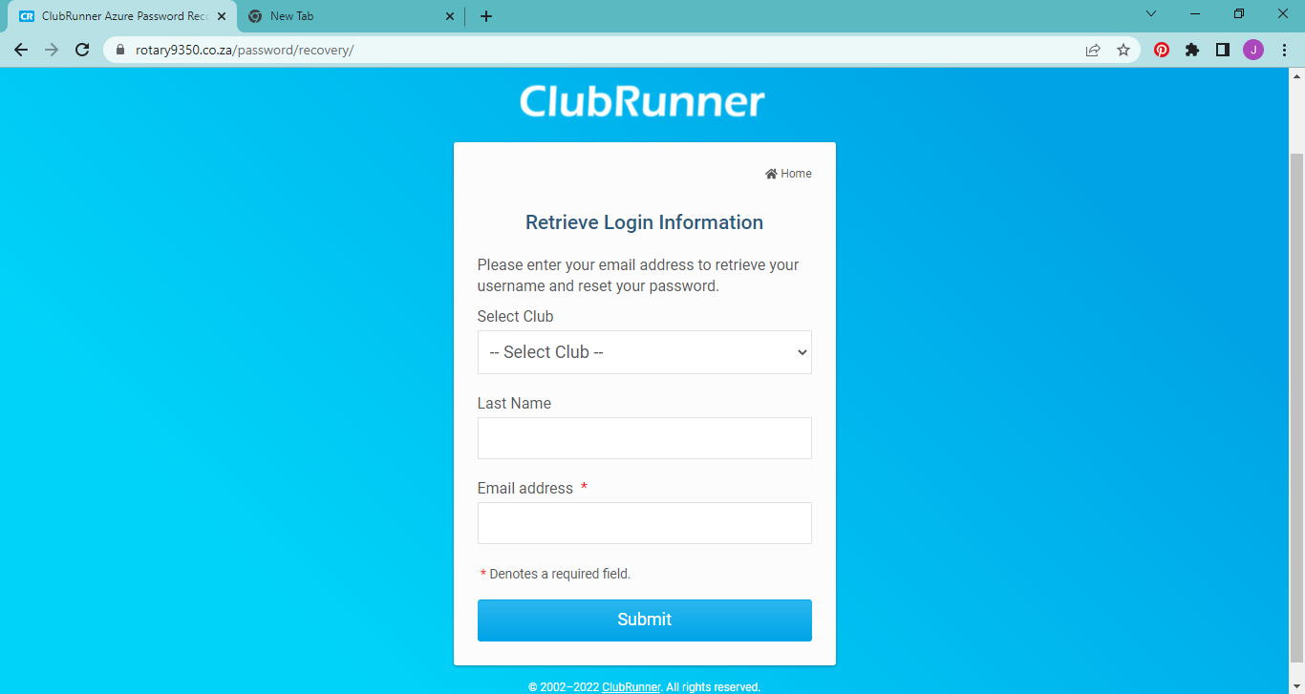
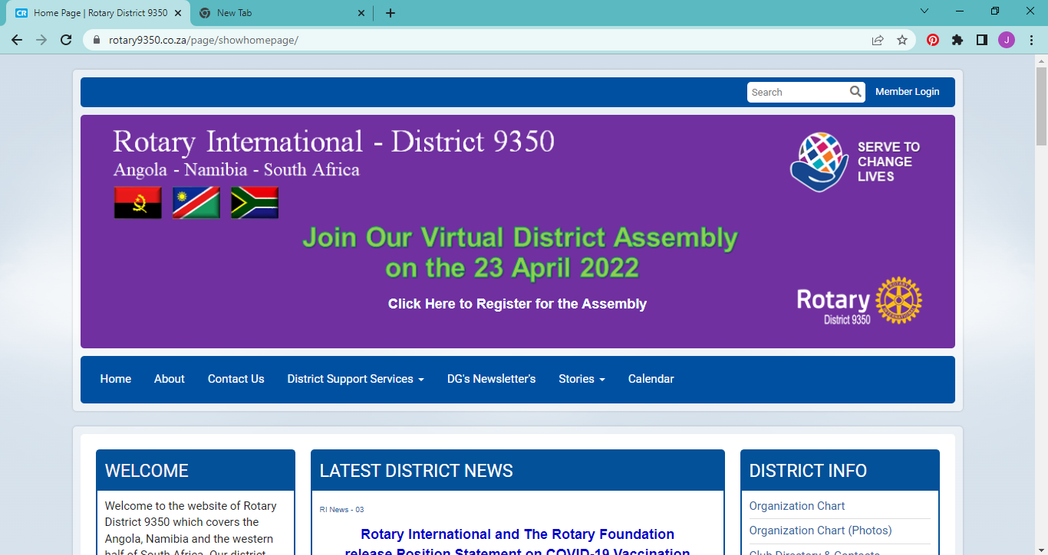
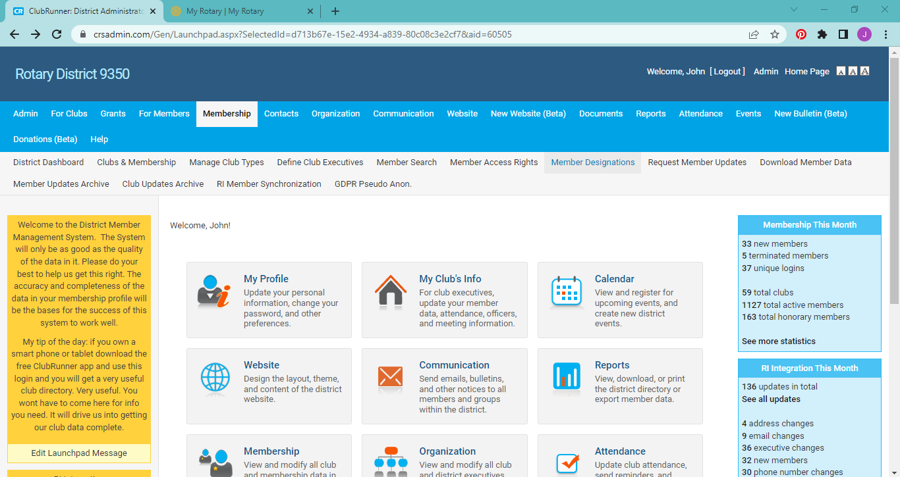
District 9350 - POETS 2022-2023
Managing Your Club with ClubRunner

Slide 8
District 9350 - POETS 2022-2023
Connect and Share
with
“My Rotary”

Slide 9
District 9350 - POETS 2022-2023
Connect and Share with “My Rotary”
● website – www.rotary.org
● Sign In to “My Rotary”
● Register

Slide 10
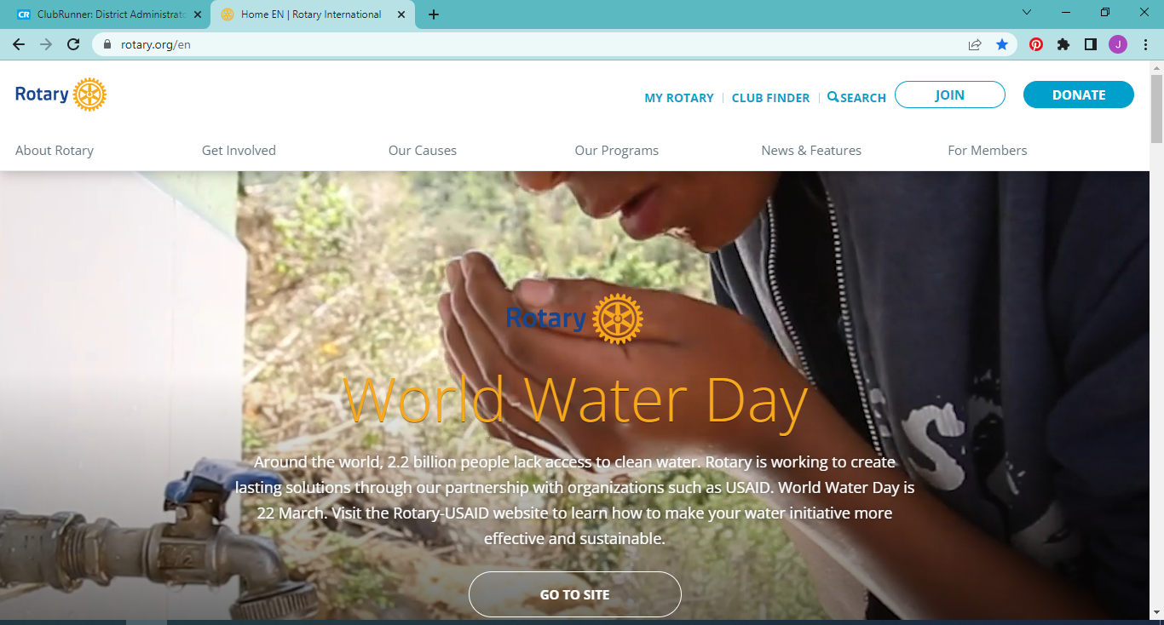
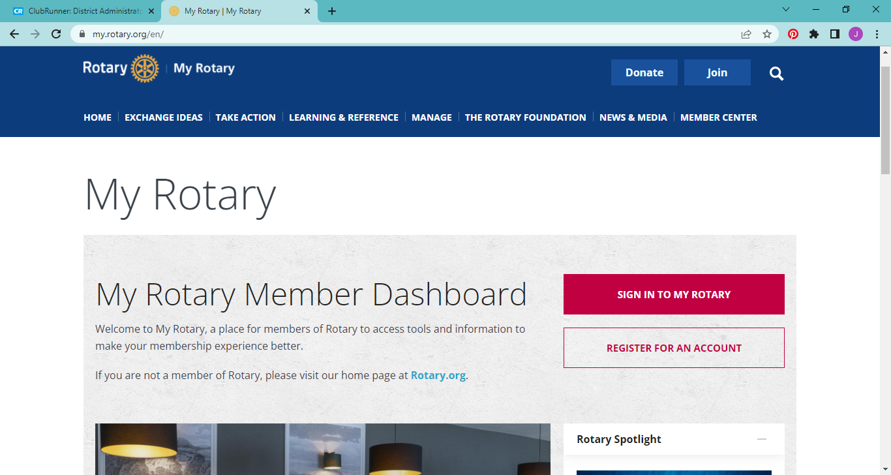
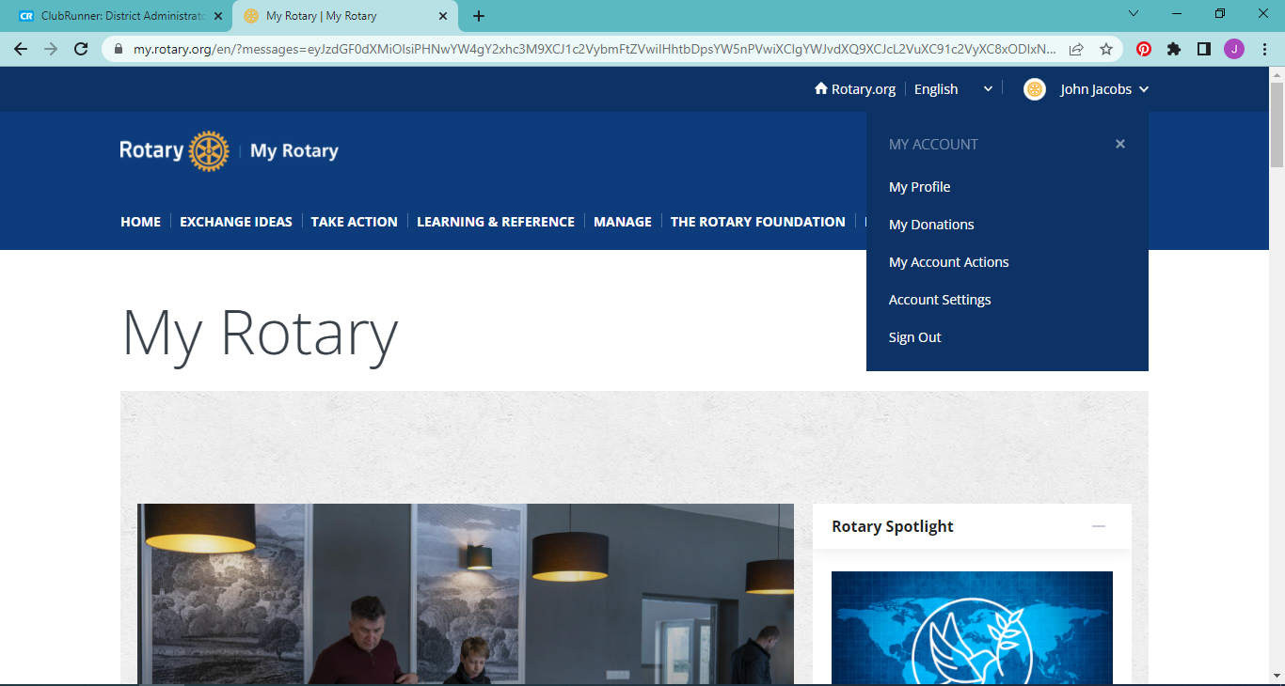
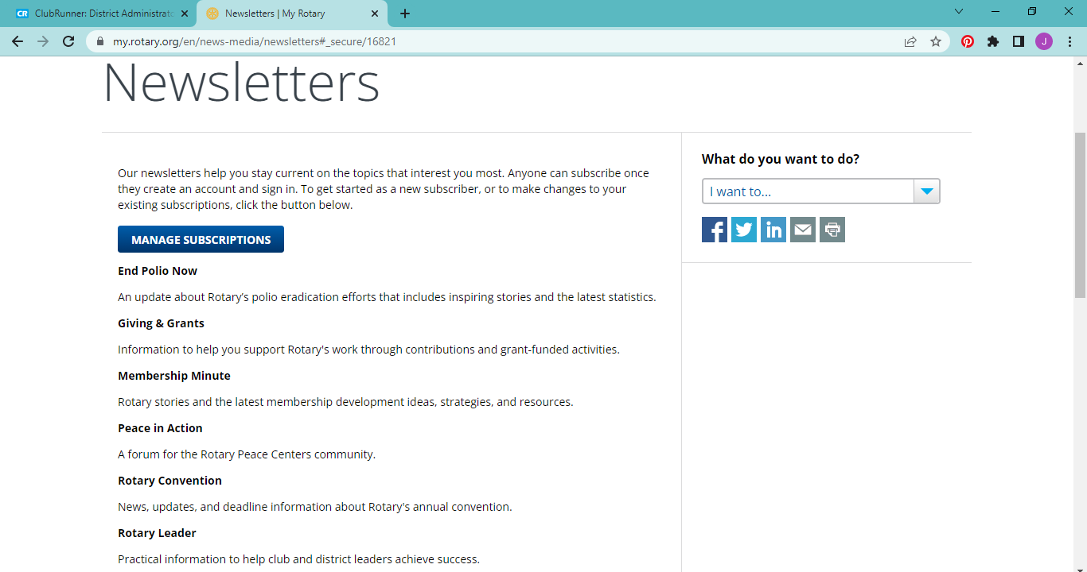
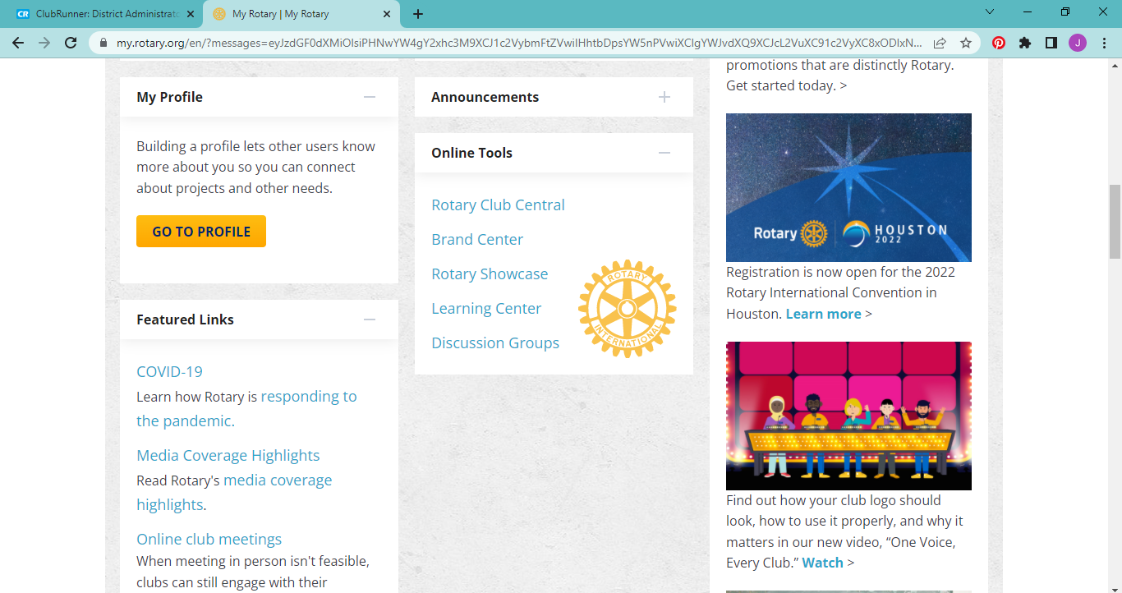
District 9350 - POETS 2022-2023
Connect and Share with “My Rotary”

Slide 11
District 9350 - POETS 2022-2023
Thank You
Q & A
jjjcms.capetown@gmail.com

