Slide 1
POETS Presidents & Officers Elect Training Seminar 2022-2023 Whatever your interactions within your Clubs – following this training – please bear in mind., what has been discuss and planned for at this POETS Session only takes effect on 1 July 2022.

Slide 2
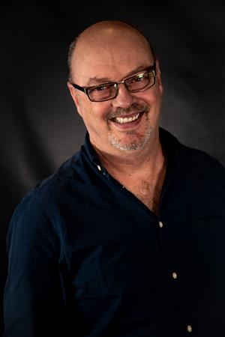
Let’s hear from a Past President…
Past President Doug Batchelor
2009 -2010
2021 -2022

Slide 3
The Board
Notes:
Choose strong members to help you lead – but take heed of diversity
This is not a 1 person show, you lead together
Pay attention to the role of secretary and treasurer – vital to the health of the club
Run sub-committees
Strive for continuity – PP, Pres and PE

Slide 4
Planning
Notes:
Plan you year ahead
Monthly themes – guest speakers that align
Meetings – Have a structured agenda and be consistent
Events – My experience, a busy club is a healthy and happy club
Don’t forget the socials

Slide 5
Communicate, communicate, communicate
Notes:
Central repository
Publish minutes of board meetings
Whatsapp groups
Facebook
Guest speakers – external mediums
Newsletter
Member welfare

Slide 6
Be Unique
Notes:
Change things up from the previous year – without being too radical!! (some people don’t like change)
Don’t be predictable
Introduce something new – eg quote of the week

Slide 7
Enjoy
Notes:
Enjoy yourself – your members will enjoy themselves to
Maintain the energy
Be flexible

Slide 8
Video – People of Action
Click Here for
Video

