Slide 1

POETS
Presidents & Officers Elect Training Seminar 2022-2023
Whatever your interactions within your Clubs – following this training – please bear in mind., what has been discuss and planned for at this POETS Session only takes effect on 1 July 2022.

Slide 2
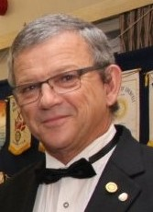
My Role as a Club Officer
Casper Kruger

Slide 3

My role and Responsibilities as a Club Officer
Understanding our roles
Understanding our members / Membership engagement
Meeting Club Goals
Reporting/ Accountability
Fun and Social
Planning, planning planning

Slide 4
GETTING PREPARED for your role as PRESIDENT..
The Check list before 01 July 2022….
  Consult with your current Club President
  Understand the club status
  Appoint your Club Board
  Be involved in the preparation of the club budget
  Create an account in My Rotary
  Set goals for your club in Rotary club central
  List your club officers in My Rotary

Slide 5

GETTING PREPARED for your role as PRESIDENT…
PLANNING and then more PLANNING…
“Plans are nothing, planning is everything!”
“Action is the Foundational key to all success!”
-Pablo Picasso

Slide 6
PLANNING YOUR YEAR
Online learning…. Club Basics; Club Secretary & Club Treasurer
Plan, plan and more planning….. Plan your year
Running your meetings
Attracting new members
Engaging club members

Slide 7

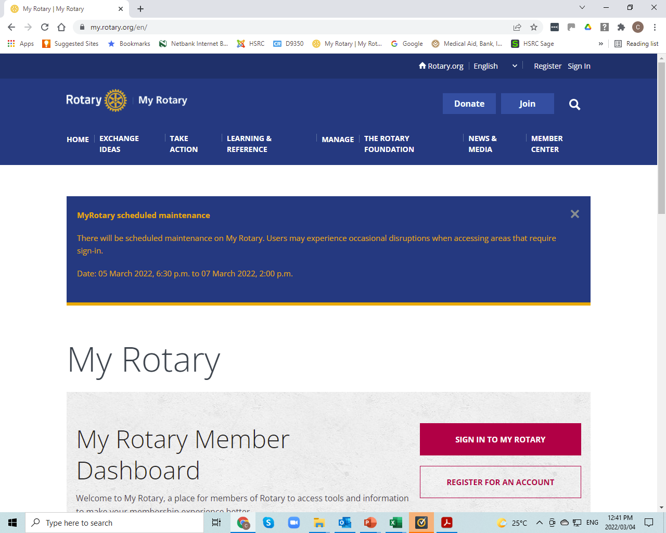
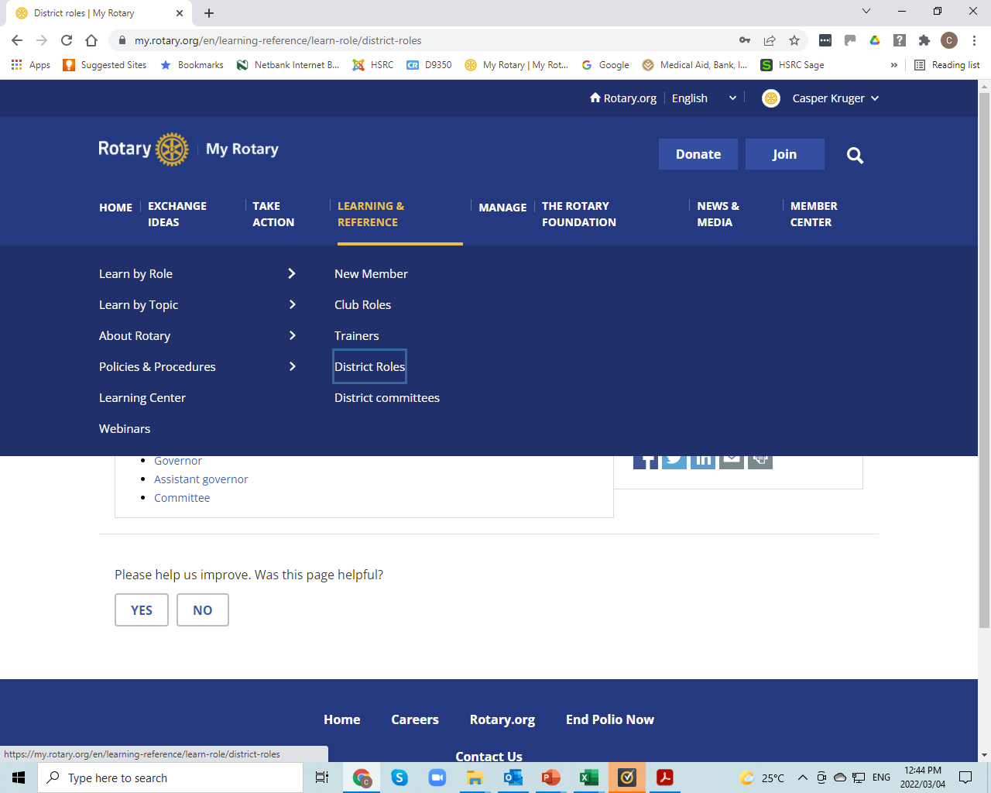
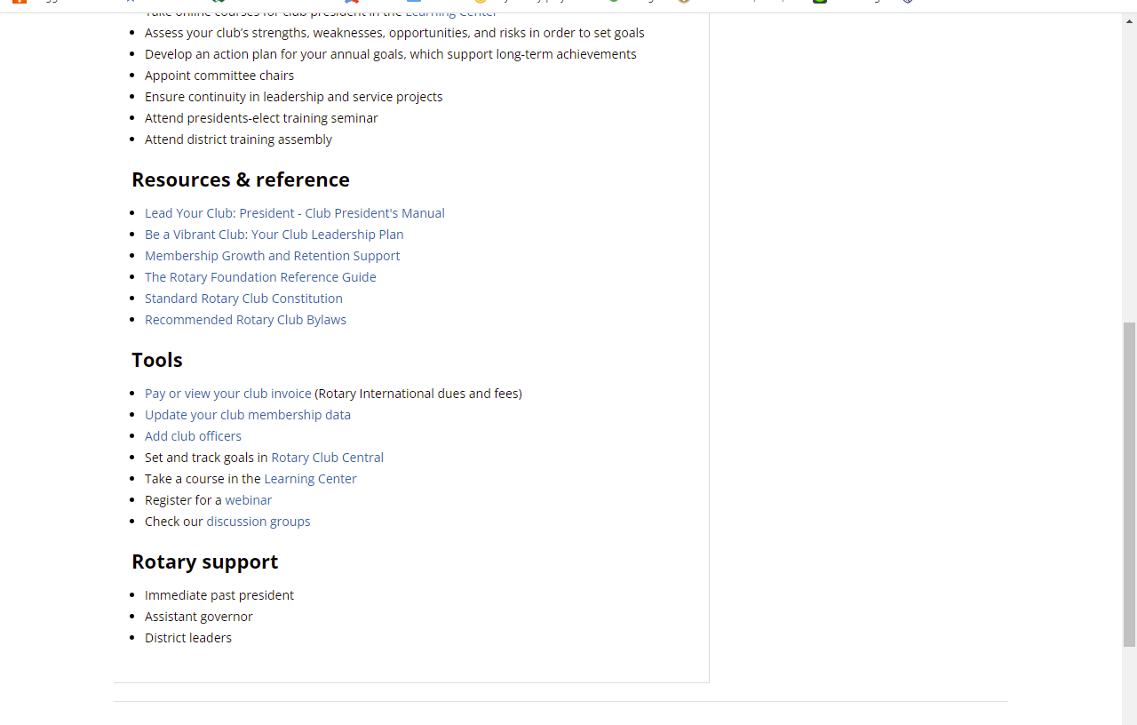
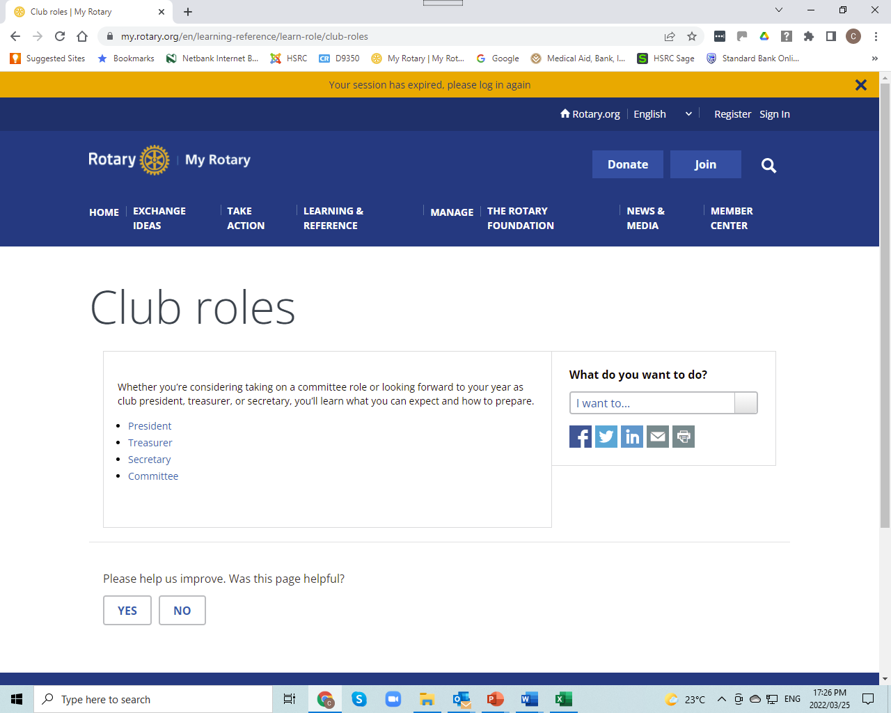
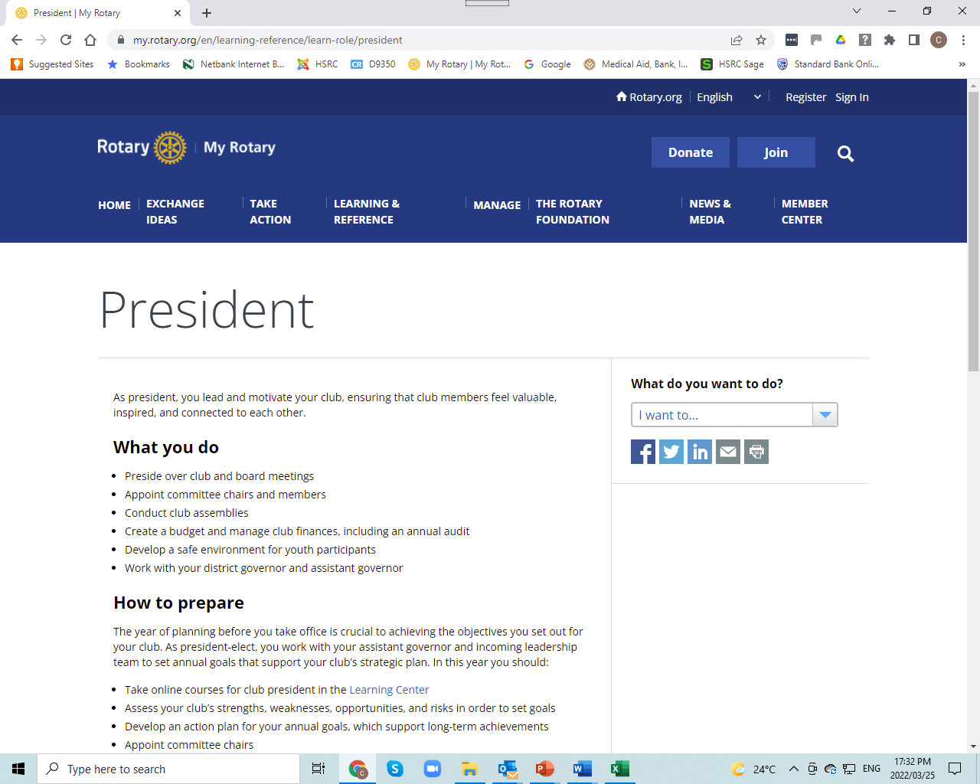
RI Website : https://my.rotary.org/en/
ONLINE TRAINING
Notes:
Let’s do the official part quickly:
DGE Tracey selected you as her team – as you can see – she had to undergo extensive training – please acknowledge that by doing your part – do the same.
PS – she can see who has and who has not!

Slide 8
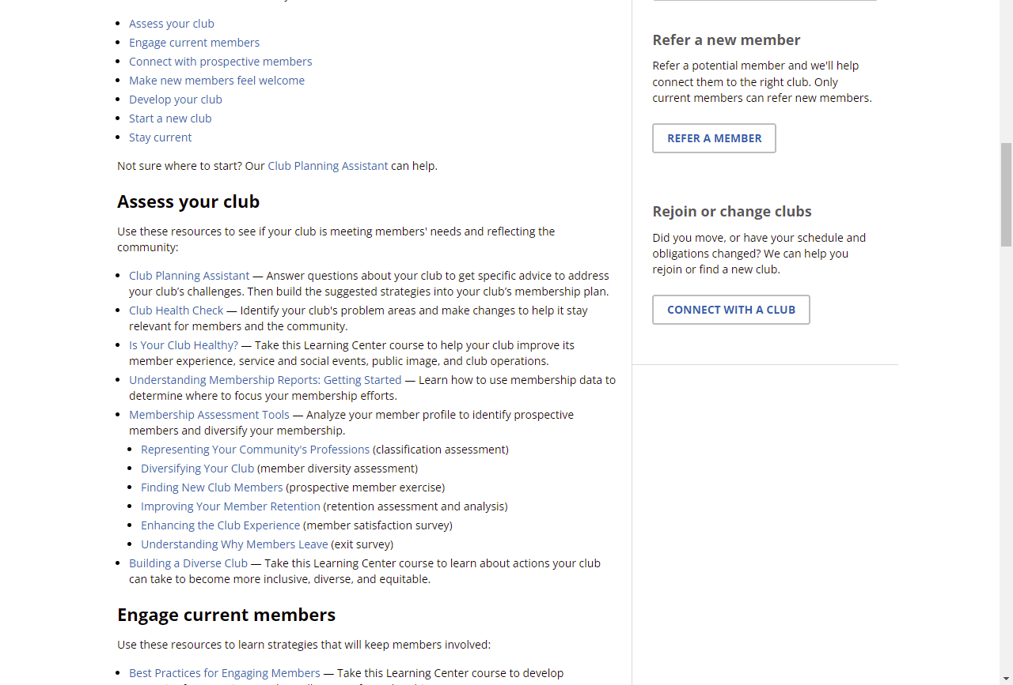
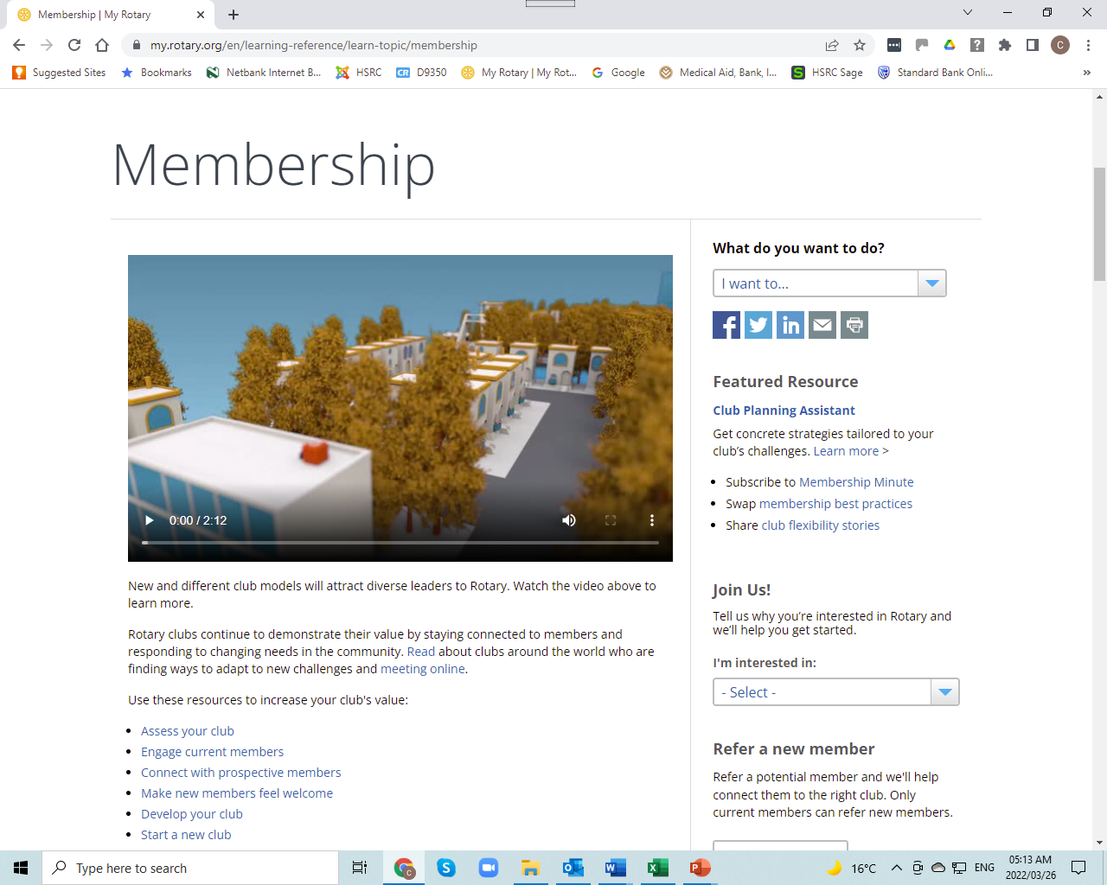
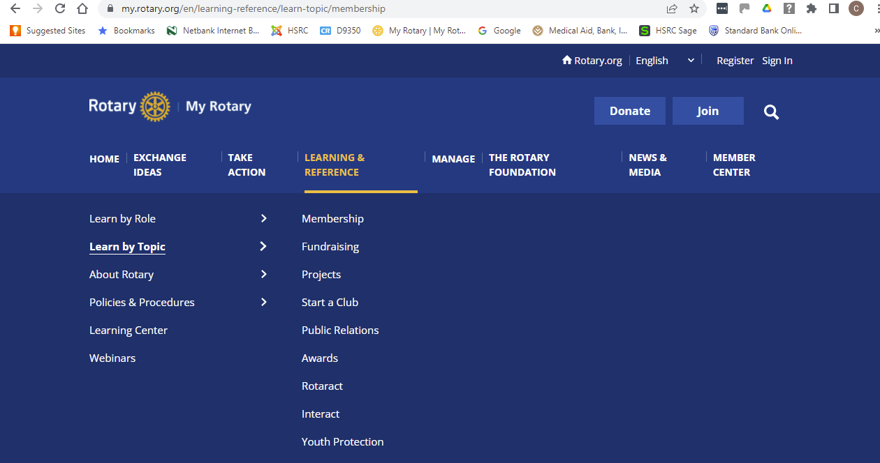
Notes:
Functionality is also available : Membership
Rotary clubs continue to demonstrate their value by staying connected to members and responding to changing needs in the community. Read about clubs around the world who are finding ways to adapt to new challenges and meeting online.
Use these resources to increase your club's value:
Assess your club
Engage current members
Connect with prospective members
Make new members feel welcome
Develop your club
Start a new club
Stay current

