Slide 1

POETS
Presidents & Officers Elect Training Seminar 2022-2023
Whatever your interactions within your Clubs – following this training – please bear in mind., what has been discuss and planned for at this POETS Session only takes effect on 1 July 2022.

Slide 2
Introduction
IMAGINE – Julian Lennon
Click Here for
Video

Slide 3
Meet the DG – Rotary
25 Oct 2005 : 1 of 7 people at 1st prospective new club meeting at Erinvale.
Charter Member of HSRC : 06 June 2006
2nd President of HSRC : 2007/08
AG : 2011/12; 2012/13 & 2015/16
District Conference Coordinator : 2010 & 2019
Shelterbox:
  Joined : 2010
  Qualified Shelterbox Response Team Member : 2011
  Deployed in Brazil & Mozambique
  Shelterbox SA Affiliate Chair : 2018-20

Slide 4
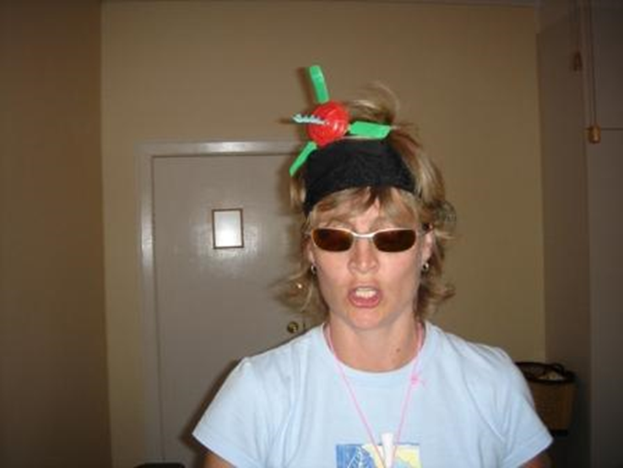
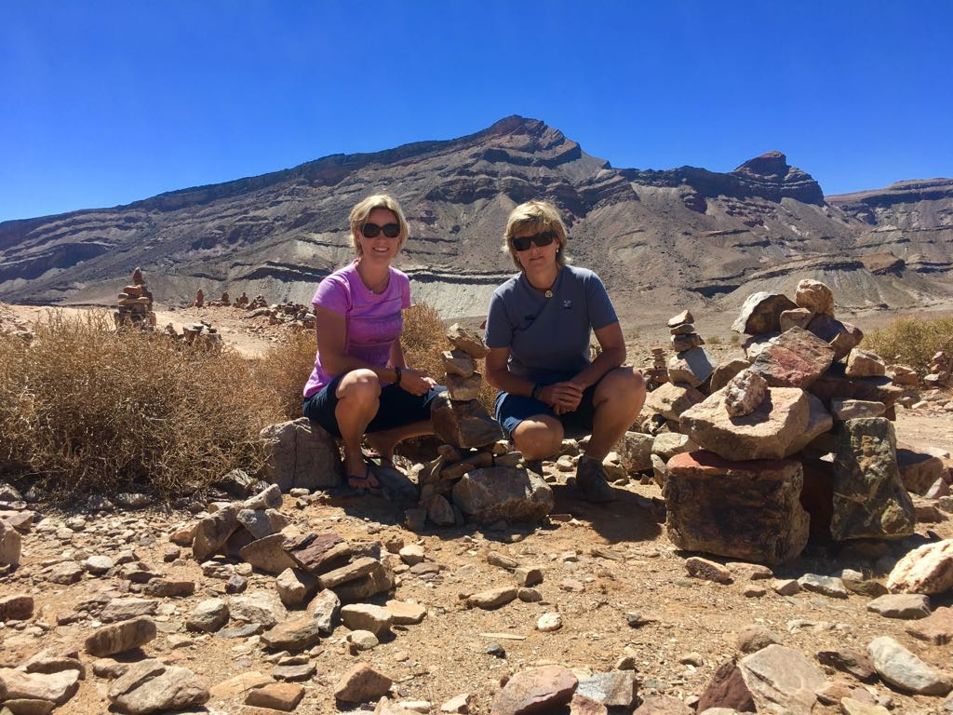
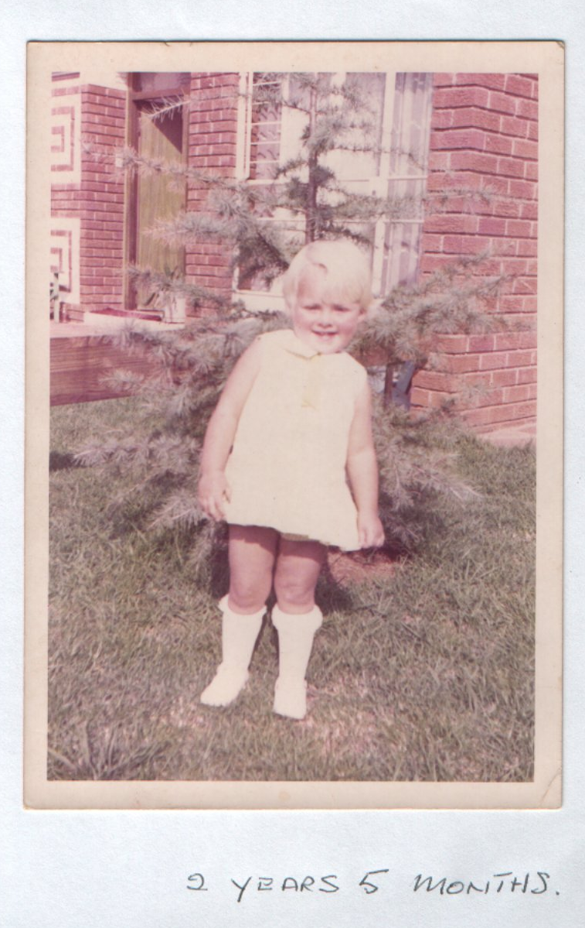
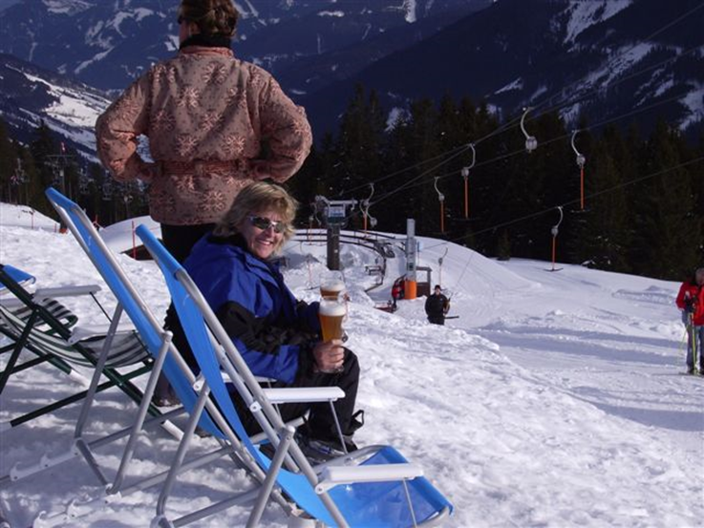
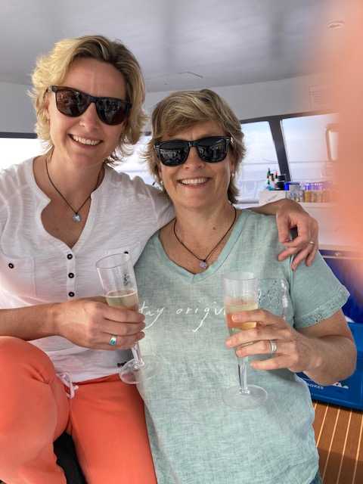

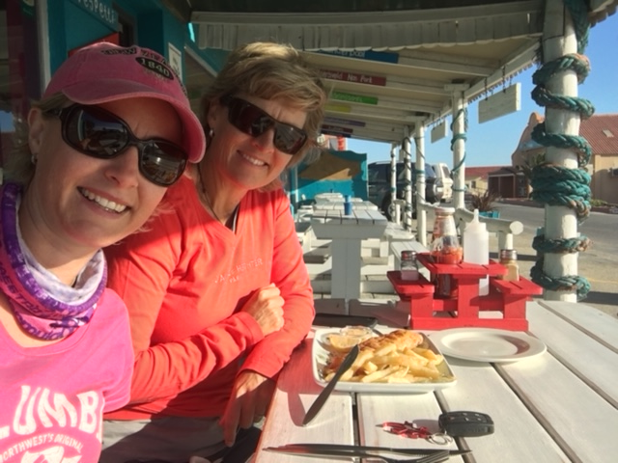
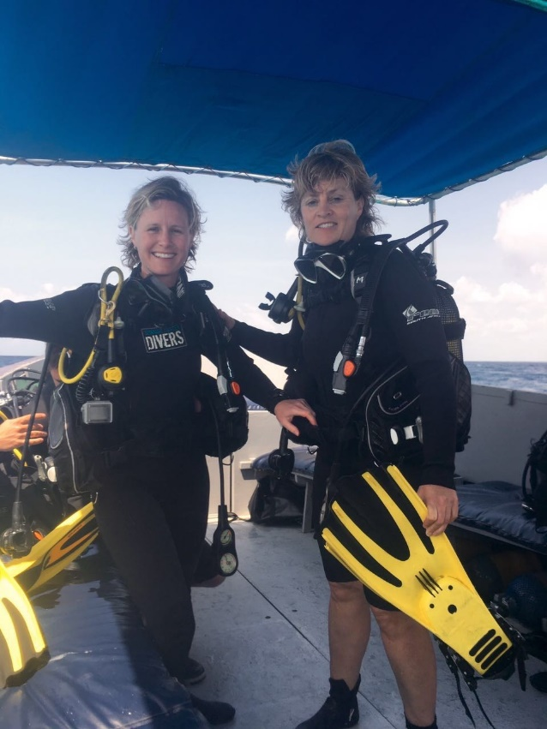
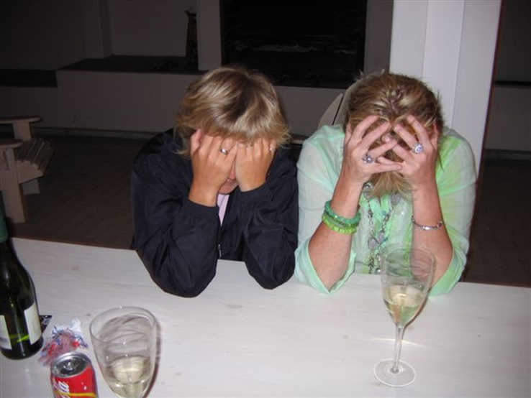

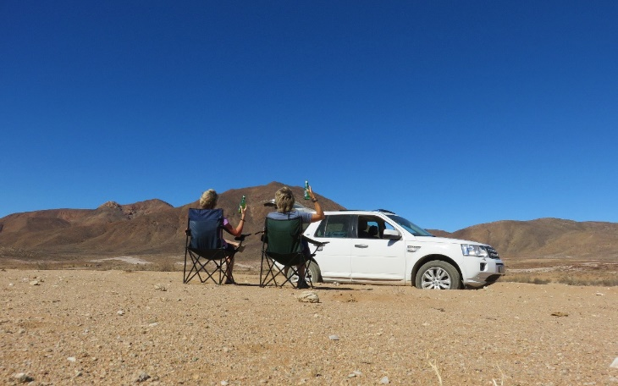
Meet the DG – outside Rotary
DG TRACEY WILSON
Director Syncro Envirnmental
Co-owner of a laundry
Black Belt in Karate
Party Animal of note
Rugby – Sharks Supporter
Enjoys the outdoors
Partner – Hildie
Dogs – Bruno & Duke

Slide 5
RI Theme for 2022-2023
Video - Imagine Rotary
Click Here for
Video

Slide 6
Key Message for 2022-2023
Video - With RI P.E. Jennifer Jones
Click Here for
Video

Slide 7
KEY MESSAGES….
1. Do we “GET ROTARY?”
2. We need to ADAPT & CHANGE to remain relevant
3. Membership growth across the board is vital, as well as COMFORT & CARE of those members
4. ROTARACTORS are to be closer than ever before….Lets embrace this!

Slide 8
We will not work through the Online Training Manuals : that’s why it’s called online learning!
We will however quickly review this.
We will not “keep looking in the rear view mirror” – each year is different:
  New RI President : Jennifer Jones
  New District Governor : Tracey Wilson
  New Theme : Imagine Rotary
  New challenges - ????????
We will be guided by experience @ Club & District Levels

