Slide 1
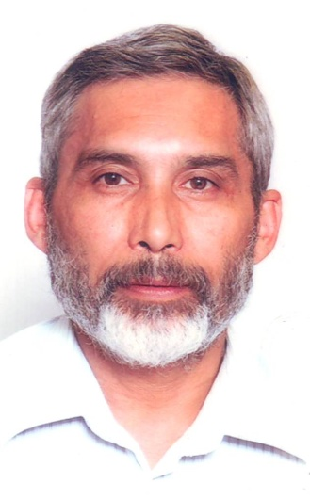
POETS 2020-2021
Presenter
John Jacobs (JJ)
District ClubRunner Administrator
Session 4
The Reward of Ongoing Learning
(keeping you and your Club updated)

Slide 2
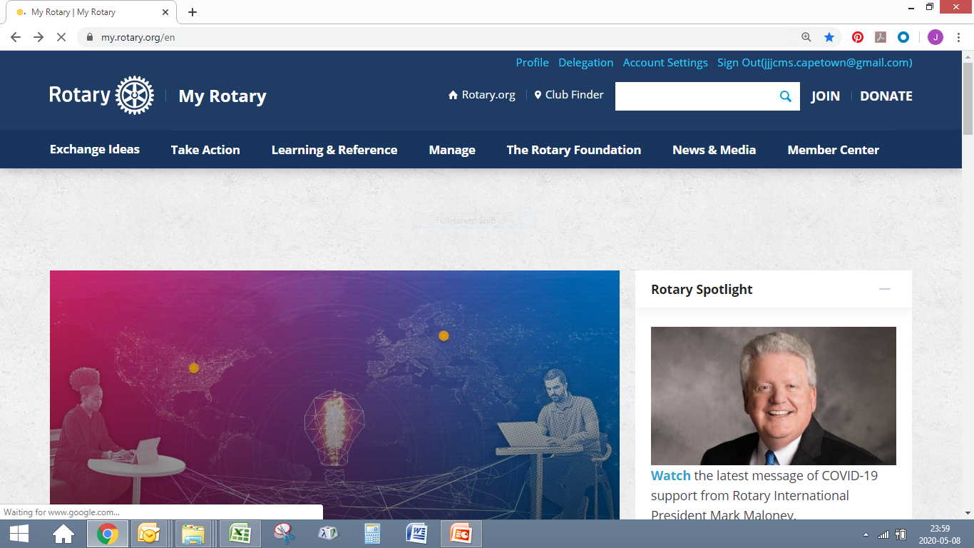
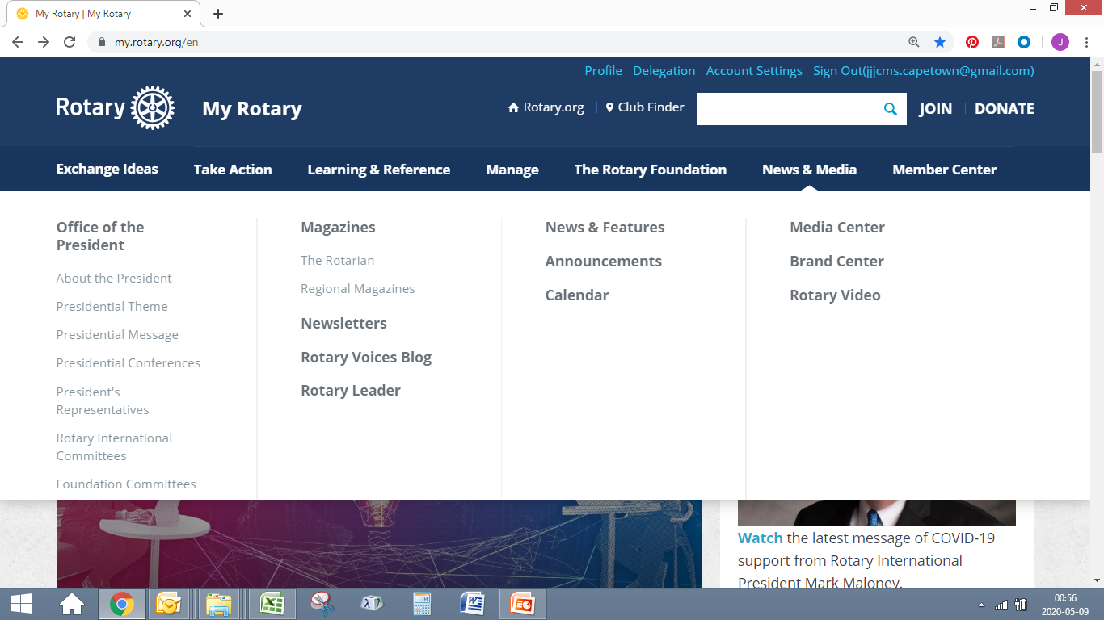
POETS 2020-2021

Slide 3
POETS 2020-2021
Where to get the latest on Rotary
First, sign into “My Rotary” to additional material
Hover on the link - News & Media
Move and Click on – Rotary Leader (best to subscribe)
also Move and Click on - Newsletters
Subscribe to the Newsletters that interests you and receive the latest news and resources.

Slide 4
POETS 2020-2021
Newsletters Available
End Polio Now
Giving & Grants
Membership Minute
Peace in Action
Rotary Convention
Rotary Leader
Rotary Service
Rotary Weekly
Rotary Youth Exchange
The Rotarian Newsletter
Training Talk
Vocational Service
Young Leaders in Action

Slide 5
POETS 2020-2021
For any
Questions or Queries
Please contact John Jacobs (JJ) at
jjjcms.capetown@gmail.com

Slide 6
POETS 2020-2021

