Slide 1
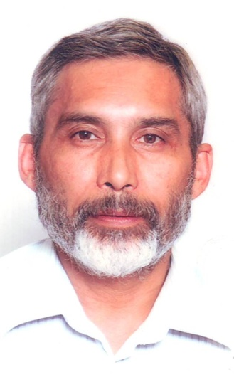
POETS 2020-2021
Presenter
John Jacobs (JJ)
District ClubRunner Administrator
Session 4
RI Learning Centre

Slide 2
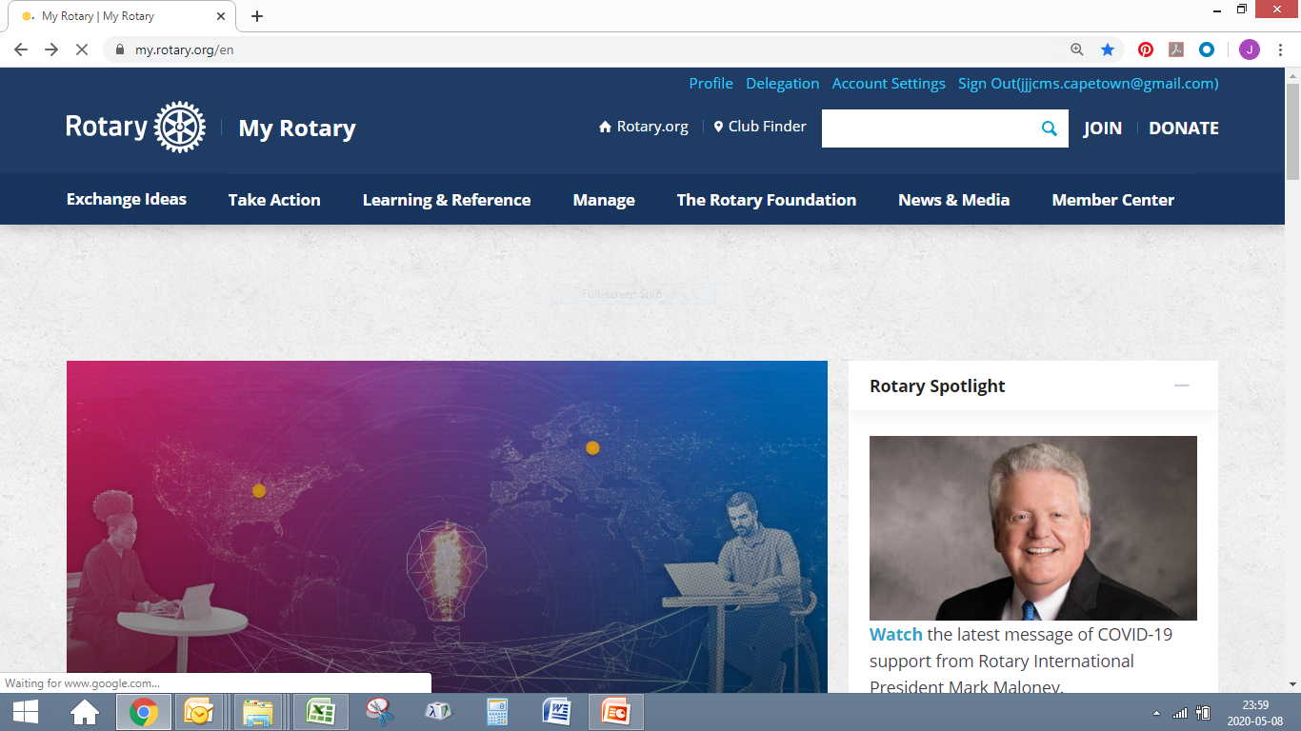
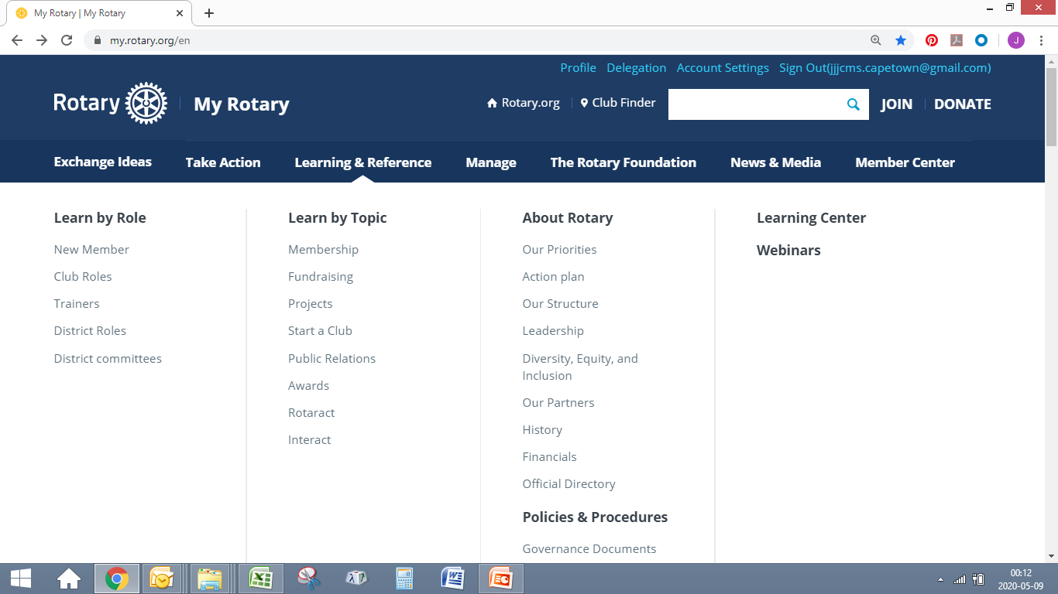
POETS 2020-2021

Slide 3
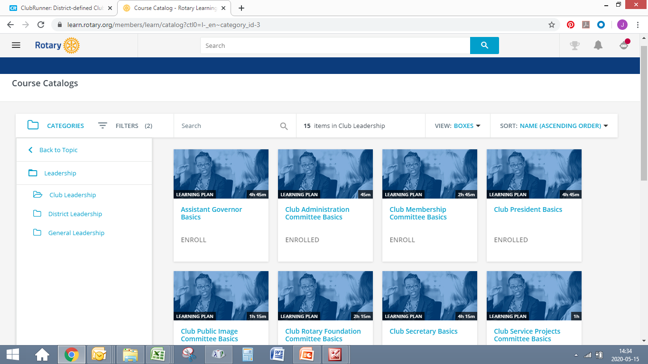
POETS 2020-2021

Slide 4
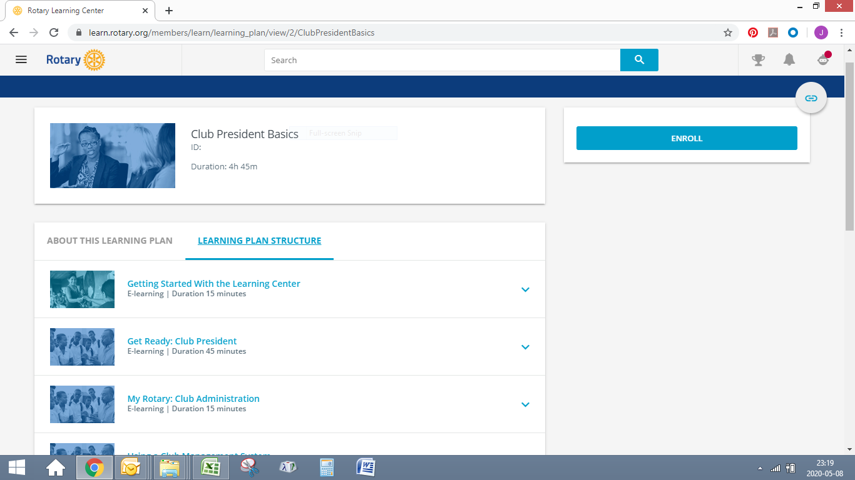
POETS 2020-2021

Slide 5
POETS 2020-2021
Learning Centre - Virtual Classroom
First, sign into “My Rotary” to access the Courses
Hover on the link - Learning and Reference
Move and Click on - Learning Centre (top right on screen)
Choose Category à Leadership à Club Leadership
View Page with Course Catalogue
Select your Course and click on ENROLL
The Course Structure is listed, just follow the sequence.
Complete the Course and Print Your Certificate

Slide 6
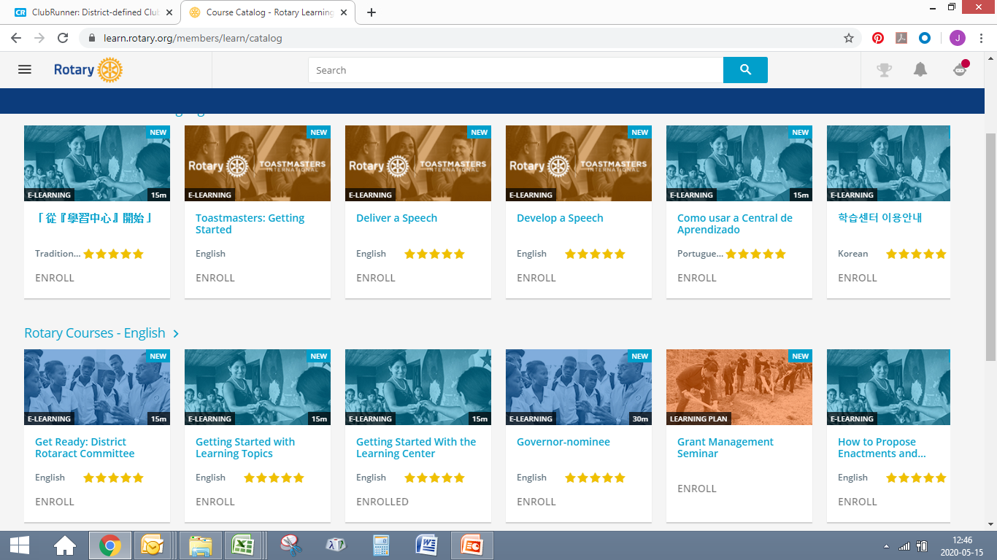
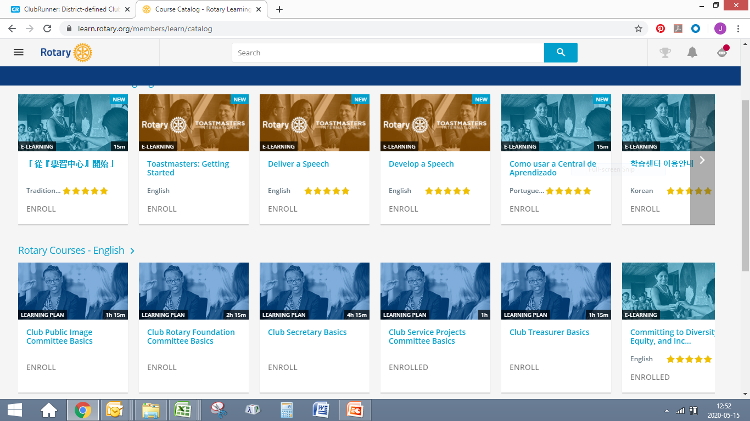
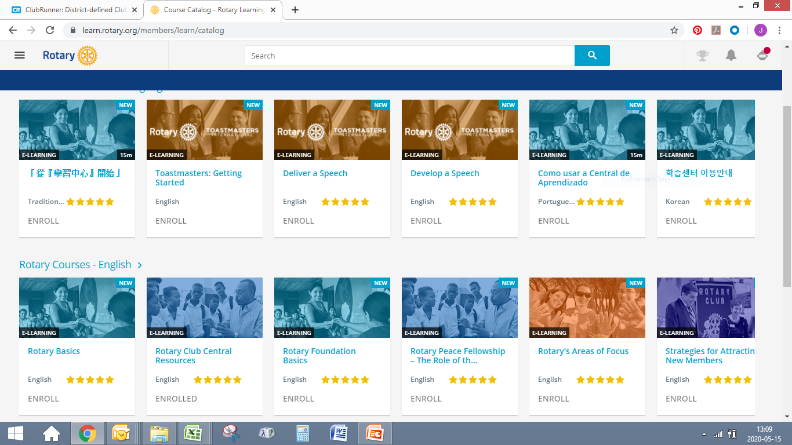
POETS 2020-2021

Slide 7
POETS 2020-2021
The Learning & Reference Page

Slide 8
POETS 2020-2021
Learning & Reference
Your “Go To” Place
First, sign into “My Rotary” to access the resources
Click on the link - Learning and Reference
Get access to all you need – Resources and Reference

Slide 9
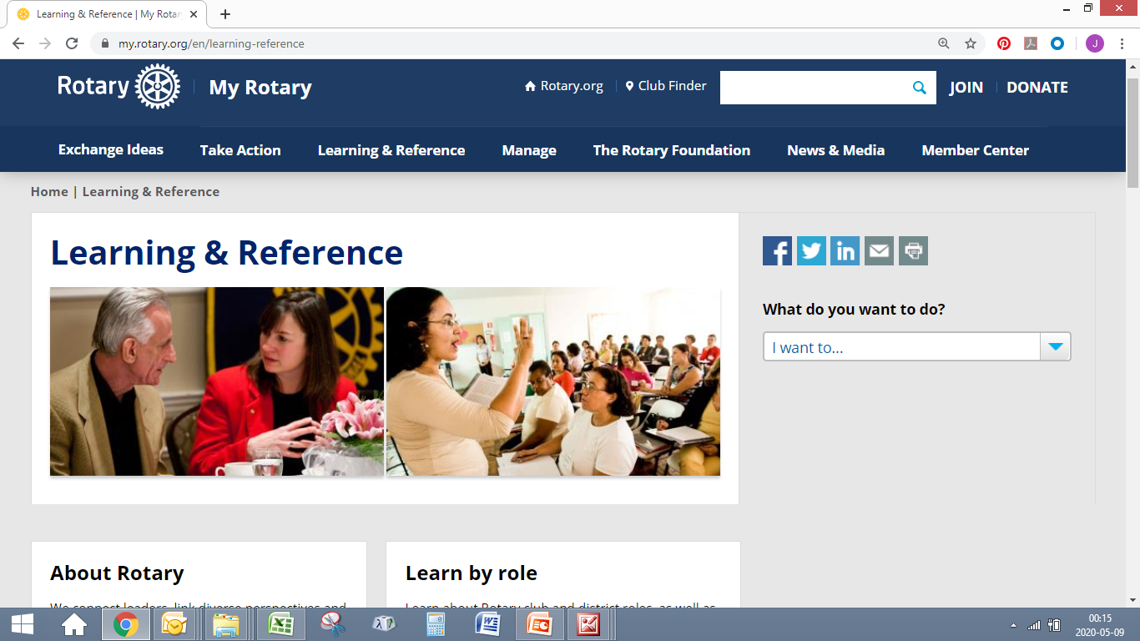
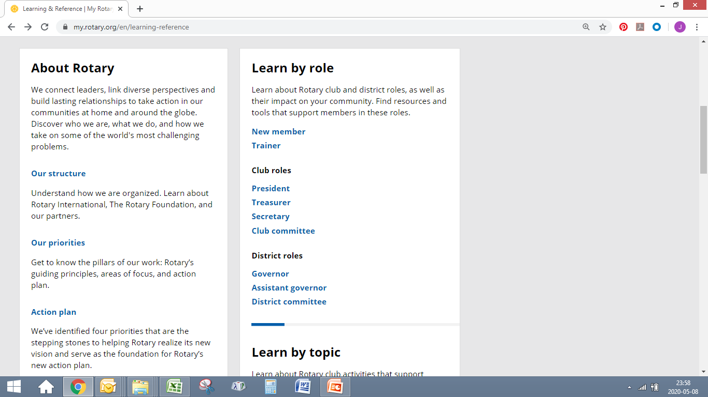
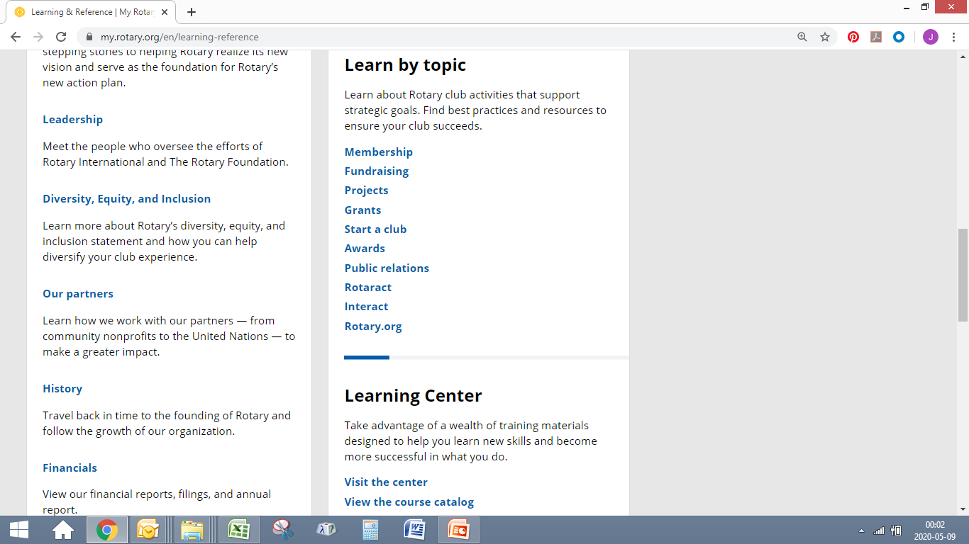
POETS 2020-2021

Slide 10
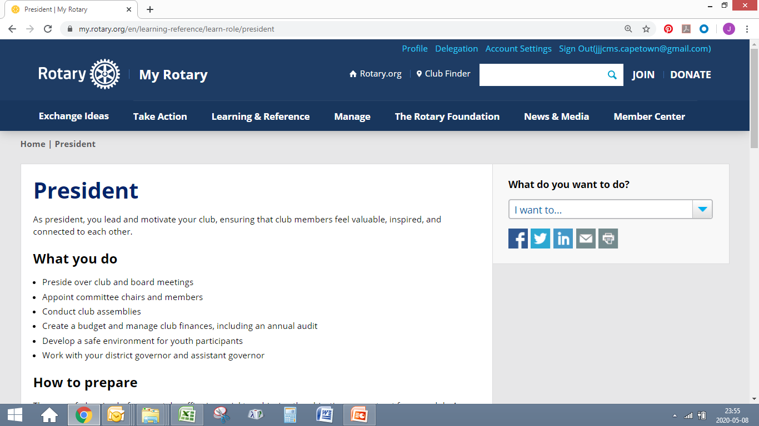
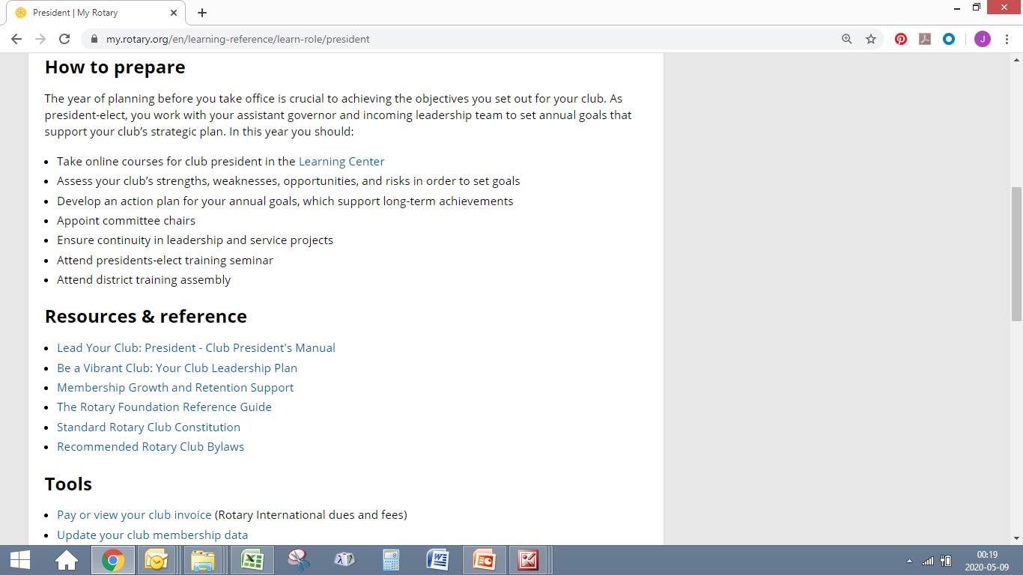
POETS 2020-2021

Slide 11
POETS 2020-2021
For any
Questions or Queries
Please contact John Jacobs (JJ) at
jjjcms.capetown@gmail.com

Slide 12
POETS 2020-2021

