Slide 1
POETS 2020-2021
The E-basics of RI and ClubRunner
DGN Ian Robertson
WEB Administrator
May 2020
Our District Footprint
Logging into MyRotary
Logging into ClubRunner
Data Integrity
Questions

Slide 2
POETS 2020-2021
Our District Footprint
WEB Site
FaceBook
WhatsApp

Slide 3
POETS 2020-2021
Logging into MyRotary
Member Data
Club administration
Citation Program

Slide 4
POETS 2020-2021
Logging into ClubRunner
Member Data
Club Data

Slide 5
POETS 2020-2021
Data Integrity
Missing Data
Incorrect Data
Data Access

Slide 6
POETS 2020-2021
Questions

Slide 7
POETS 2020-2021
The E-basics of RI and ClubRunner
DGN Ian Robertson
WEB Administrator
May 2020
Our District Footprint
Logging into MyRotary
Logging into ClubRunner
Data Integrity
Questions

Slide 8
POETS 2020-2021
Our District Footprint
WEB Site
FaceBook
WhatsApp

Slide 9
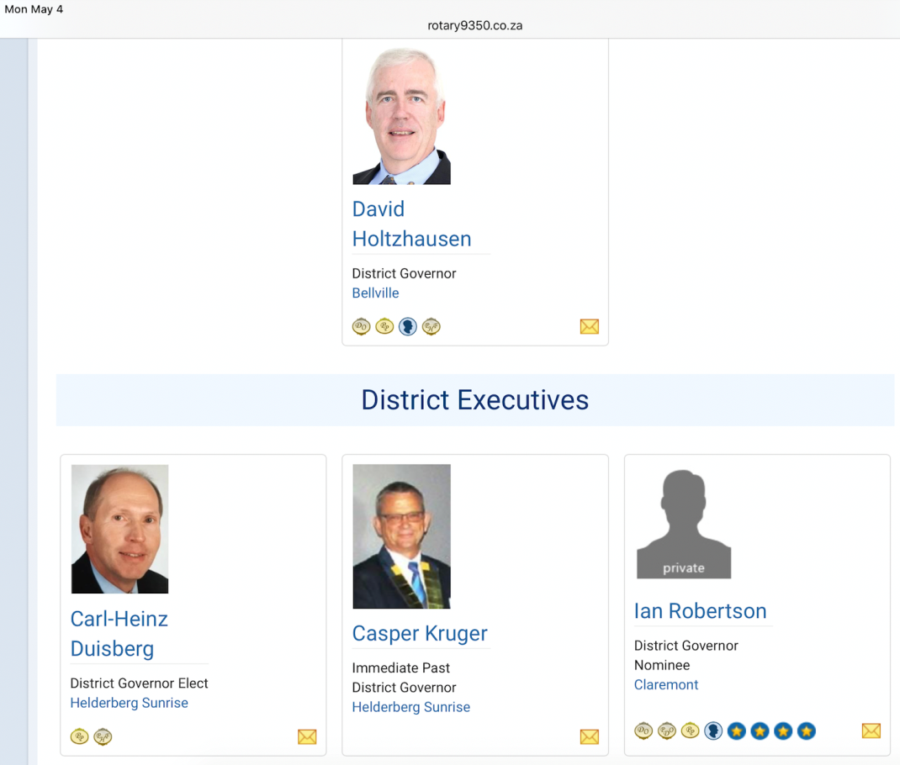
POETS 2020-2021
Google
Google, Rotary District Orginization
You Get exposure to D9350 right away
Then D9370 and D9400
You will also get incomplete data

Slide 10
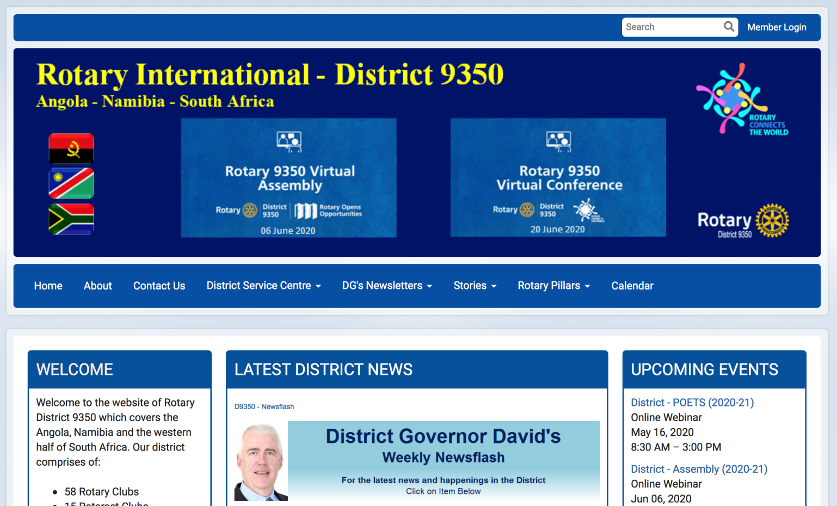
POETS 2020-2021
WEB Site
Using your internet browser
Type www.rotary9350.co.za
Up to date
Notice: Member Login

Slide 11
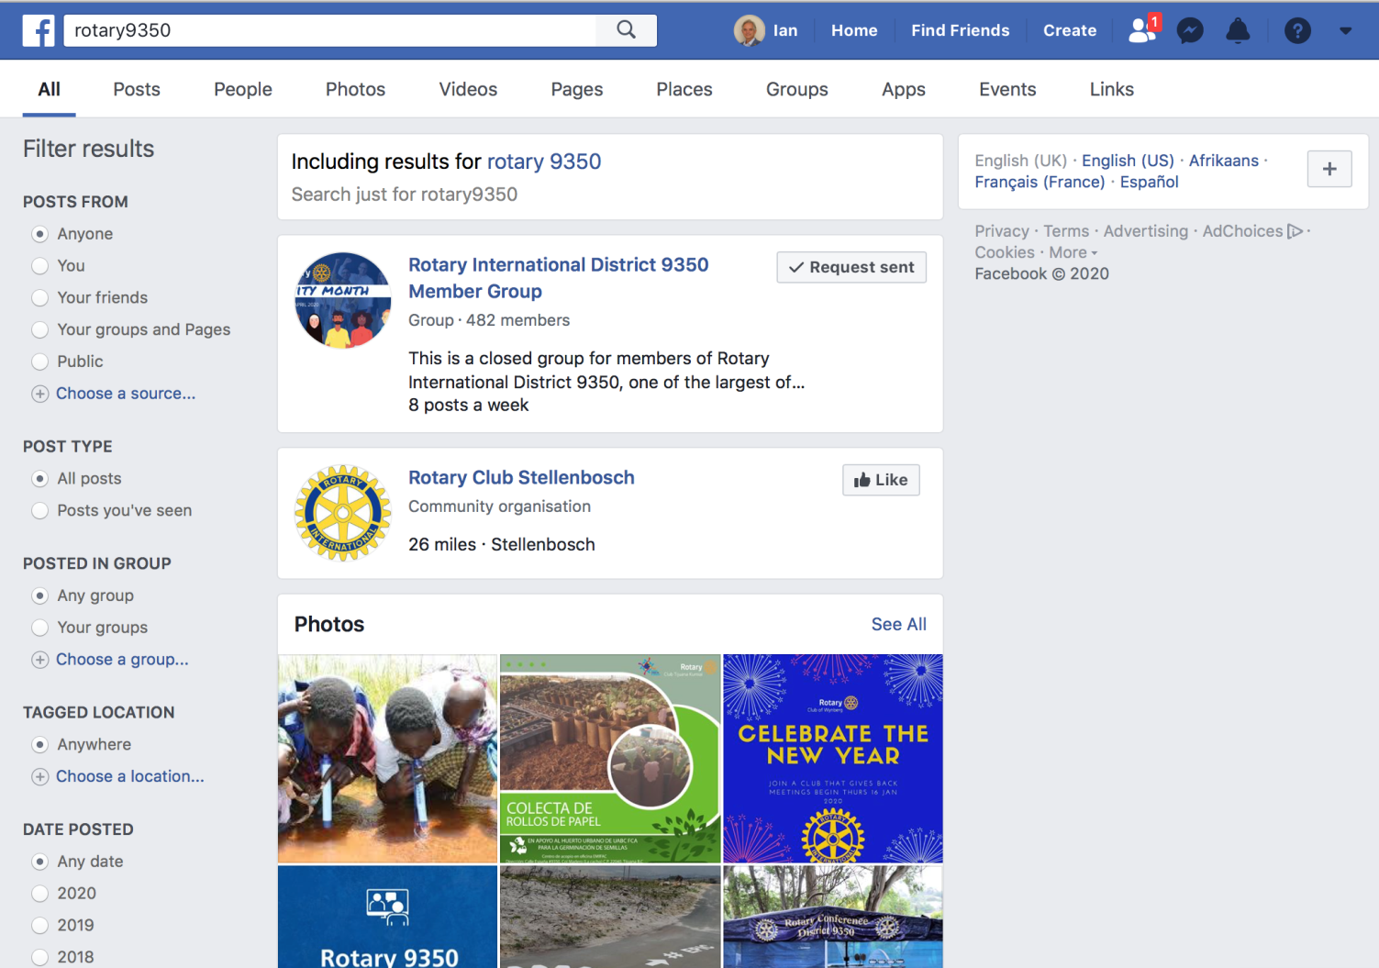
POETS 2020-2021
FaceBook
Create your own account
Be very conservative
Join FB: Rotary 9350
Up to date
Well managed

Slide 12
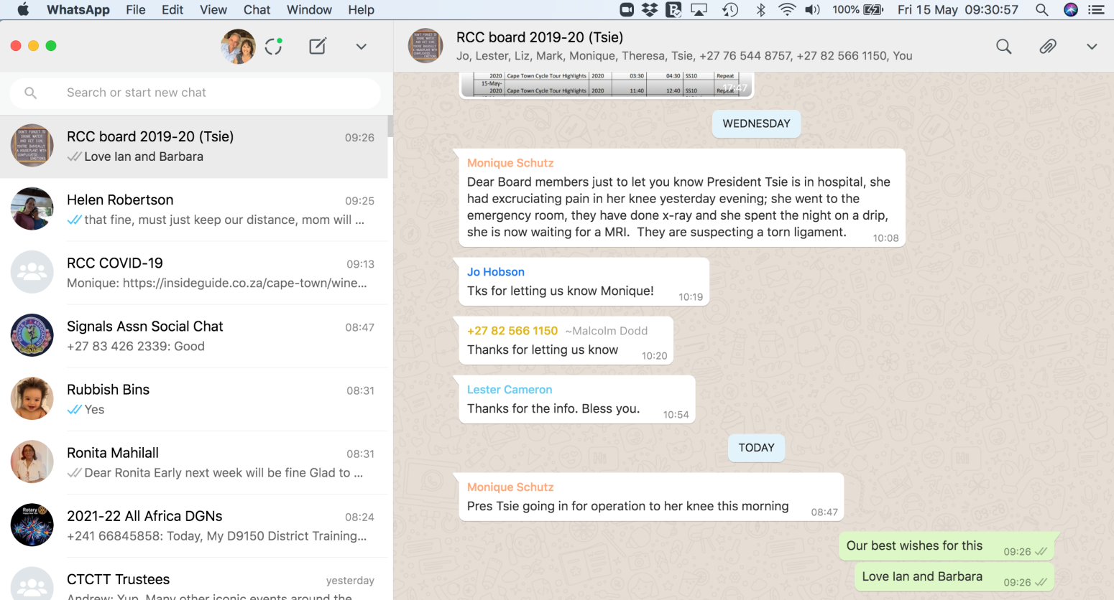
POETS 2020-2021
WhatsApp
Useful Tool
Used Correctly
DG to Presidents, one way
AGs to presidents, both ways
DG to AGs both ways
One on One
Long phone calls

Slide 13
POETS 2020-2021
Logging into MyRotary
Member Data
Club administration
Citation Program

Slide 14
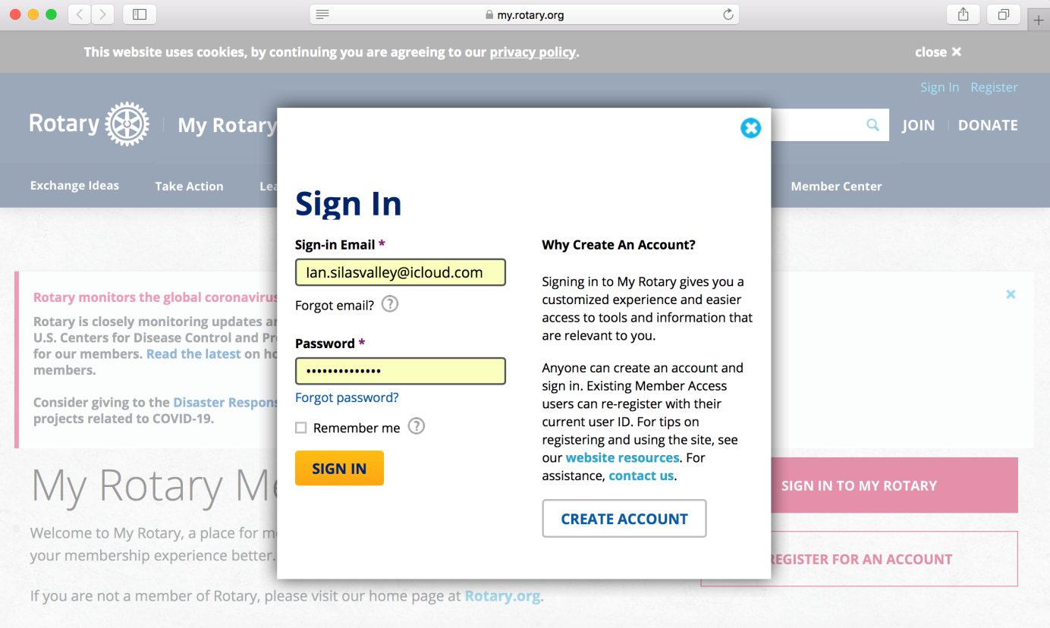
POETS 2020-2021
Logging into MyRotary
Open Bowser
Enter URL: www.myrotary.org
Select: SignIn
Use your e-mail
Then your PassWord
As for help !
Get to know this sight in steps
Decide what you want to achieve
keep notes on how you got there

Slide 15
POETS 2020-2021
Logging into ClubRunner
Member Data
Club Data
Much easer than MyRotary

Slide 16
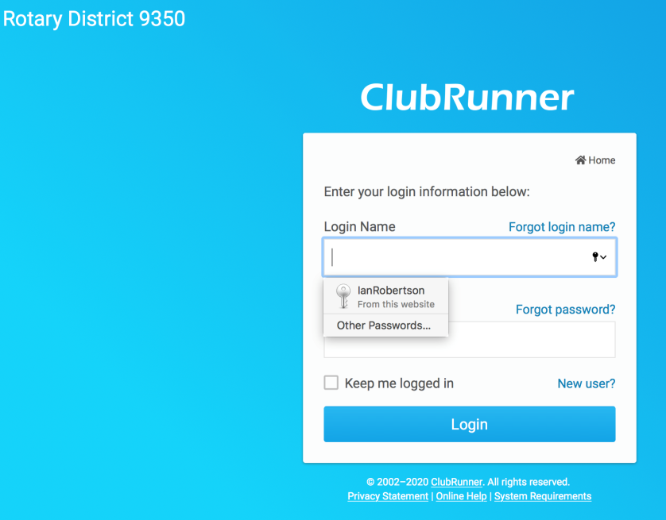
POETS 2020-2021
Logging into ClubRunner
Open Browser
Enter URL: www.rotary9350.co.za
Select Member Login
All you need is you e-mail address
If this dose not work ask for help
Ian or JJ or Club Secretary

Slide 17
POETS 2020-2021
Data Integrity
Missing Data
Incorrect Data
Data Access

