Slide 1
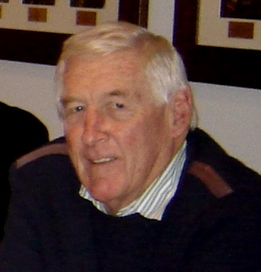
POETS 2020-2021
Peter Hugo
District 9350 Administrator
District Handbook
Your Aide during Your Year

Slide 2
POETS 2020-2021

Slide 3
POETS 2020-2021
2020-21 Per capita levies
 | Budget 2020/21 | Budget 2019/20 | Rand increase | % increase
Administration | 308 | 279 | 39 | 10.7
Service Centre | 272 | 268 | 4 | 4
Conference | 90 | 86 | 4 | 0
Total levy | 670 | 633 | 37 | 6
less Saving on Conv. | - 35
Levy for 2020-2021 | 635
Note: New members pay 50% of the total levy as at 1 January 2021

Slide 4
POETS 2020-2021
Rotary Payments
District levies
RI dues
Rotary Africa
Rotary Foundation Contributions
Grants
Special Giving
Check accounts and payment references

Slide 5
POETS 2020-2021
Handbook Information
RI President’s Citation for Clubs
Details of how to qualify
District 9350 Conference awards
List of awards and trophies and criteria
Club Bulletin Awards - PP Myra Goldenbaum

Slide 6
POETS 2020-2021
Important Dates
Centenary of Rotary in Africa
First Club in Africa chartered in April 1921
Celebration at Emperors Palace, Johannesburg
23 – 25 April 2021
Rotary District 9350 - Conference 2021
Venue : Oudtshoorn
Dates : 30 April and 1 May 2021

