Slide 1
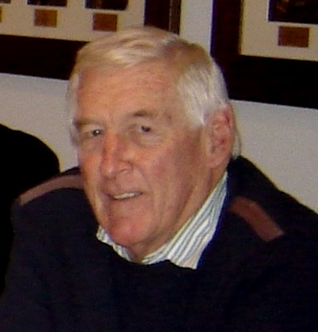
POETS 2020-2021
Peter Hugo
District 9350 Administrator
Administration and Tax Compliance

Slide 2
POETS 2020-2021
Tax Compliance
Is Your Club Compliant?

Slide 3
POETS 2020-2021
Tax Compliance
Three Steps:
Registration as Taxpayer
Registration as a Public Benefit Organisation
Submit Annual Returns

