Slide 1
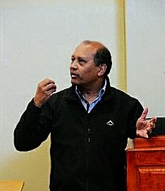
Jeromé O'Ryan Rotary Foundation Chairperson 2019-21, Assistant Governor 2019-20 SAQA Accredited Assessor (TVET Educational Sector)
POETS 2020-2021

Slide 2
Our Foundation.
Rotary Foundation
Global Grants
District Grants
GMS Online (JJ)
Scale Grants
Email: dist9350@iafrica.com

Slide 3
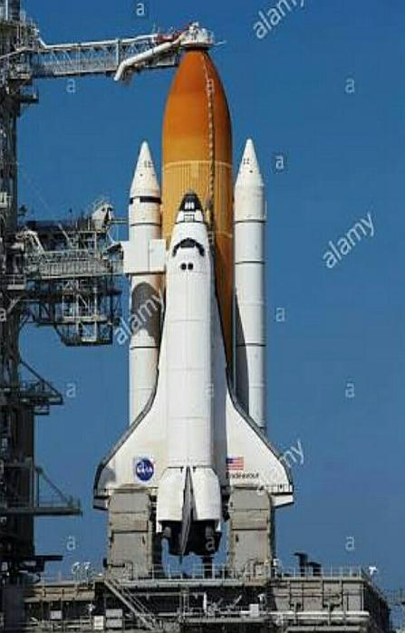
Composition of Foundation:
Abridged Version:
Rotary International:
RI is a service organisation that brings like minded people together, provide humanitarian service
and advance goodwill and peace.
Foundation:
Supports RI objectives.
Clubs:
Reflects Rotary's principles of tolerance
and shared service ideals and projects.

Slide 4
A NOVICES TAKES ON NEW GRANTS:
Global grants is a process whereby Rotary clubs as well as partners of Rotary join forces to support one of the six
areas of focus
These reflect critical humanitarian needs.
Research is done and a project is identified.
Clubs work hand in hand adhering to all legal, training and monetary requirements.
It is important to work with, educate and include the community members in the process.
This will ensure that the community is given the correct
skills to maintain the project.
Notes:
Global grants fund projects and activities that relate to the goals of the areas of focus and are sustainable and measurable. Global grants provide larger awards for projects and activities with a minimum World Fund award of US$15,000, resulting in a total project cost of $30,000 and above. Because global grants include a World Fund match, they are a flexible and economical option for scholarships. In addition, clubs can partner to develop holistic projects that incorporate humanitarian and educational activities in the same grant, again, as long as it relates to the areas of focus. Packaged grants are unique to the new grant model in that they are the grants supported by the Foundation and the strategic partner. The grants/projects are then “packaged” and offered as project opportunities for Rotarians in pilot districts. Rotary clubs in pilot districts will have the opportunity to work with The Rotary Foundation’s strategic partners on pre-designed projects funded by the World Fund and the strategic partner. Sponsoring Rotary clubs and districts will not be asked to provide a financial contribution to the project. Packaged grants are pre-designed grants that demonstrate potential grant activities that relate to Rotary’s areas of focus and activity types. They also increase the Foundation’s profile in the non-profit world and help attract donors. They also offer opportunities to clubs with limited resources and for clubs that are not familiar with the Foundation’s grants or how to design projects. The packaged grant portfolio lists current packaged grant opportunities and how they relate to the areas of focus and activity types.

Slide 5
THE ROTARY FOUNDATION
The best bank ever…….!
Program of Scale
Email: dist9350@iafrica.com

Slide 6
Global Grants – T & C’s:
No BEE Ratings required.
No credit ratings assessed.
Expand your Rand, apply for Global Grants.
MANDATORY:
Rotary Ethics.
Due diligence.
Partnerships.
Attend POETS (online qualifications).

Slide 7
Global Grants T & C’s
Major long term projects minimum value US $ 30 000.
Project must address an area of focus
Must be sustainable.
(CH)
Notes:
Global grants fund projects and activities that relate to the goals of the areas of focus and are sustainable and measurable. Global grants provide larger awards for projects and activities with a minimum World Fund award of US$15,000, resulting in a total project cost of $30,000 and above.
Because global grants include a World Fund match, they are a flexible and economical option for scholarships. In addition, clubs can partner to develop holistic projects that incorporate humanitarian and educational activities in the same grant, again, as long as it relates to the areas of focus.
Packaged grants are unique to the new grant model in that they are the grants supported by the Foundation and the strategic partner. The grants/projects are then “packaged” and offered as project opportunities for Rotarians in pilot districts.
Rotary clubs in pilot districts will have the opportunity to work with The Rotary Foundation’s strategic partners on pre-designed projects funded by the World Fund and the strategic partner. Sponsoring Rotary clubs and districts will not be asked to provide a financial contribution to the project.
Packaged grants are pre-designed grants that demonstrate potential grant activities that relate to Rotary’s areas of focus and activity types. They also increase the Foundation’s profile in the non-profit world and help attract donors. They also offer opportunities to clubs with limited resources and for clubs that are not familiar with the Foundation’s grants or how to design projects. The packaged grant portfolio lists current packaged grant opportunities and how they relate to the areas of focus and activity types.

Slide 8
When in doubt …………….. READ THE INSTRUCTIONS !
Guide to Global Grants
GG Community Assessment Results.
GG application template.
Supporting documentation :
Co-operating Organizations.
MOU Training Plan.
Monitoring and Evaluation Plan etc. etc.

Slide 9
Finding the.......... Money
Partners
Relationship building.
Rotary Friendship exchanges – host and travel.
Take potential donors to see actual project.
Communicate regularly.

Slide 10
Partners
RI Convention.
Use your International Connections.
Linkedln.
Talk to your Inter Country Committee.
Rotary showcase / Facebook.
Friendship Exchanges.
Access www.rotary.org/grants.

Slide 11
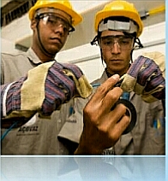
District Grants:
Educational and humanitarian activities consistent with Foundation mission
Smaller activities and projects.
Fund both local or international
activities.
Local decision making with
broad guidelines.
Funds managed by district.

Slide 12
District Grants
Complete application.
Sign MOU.
Submit to District by due date (June 2020).
Submit report on completion of project.
No further District Grants for any clubs unless all final reports for 2019 grants have been submitted by 30 May 2020.

Slide 13
District Grant DDF Contribution
District will match Rand for Rand club contribution.
Minimum contribution from club R 5000.
Maximum DDF contribution R 25 000 per project subject to availability.
Prioritisation of projects if more than one project is submitted.

Slide 14
AREAS OF FOCUS
Peace
and
Conflict Resolution
Disease Prevention and Control
Maternal and Child Care
Water and Sanitation
Economic and Community Development
Basic Education and Training

Slide 15
Needs Assessment
Talk to community.
Base project on needs of community.
Assess resources of your club and source potential partners.
(PH)

Slide 16
Sustainability
Giving a community the skills and knowledge to maintain the project.
Ensure long-term impact after Grant funds have been spent.

Slide 17
Where does the money come from?
Our Contributions to the Foundation.
Club contributions
Bequest Society
Paul Harris Society.

Slide 18
District 9650 Foundation Feedback:
Our District receives far more than we contribute.
As District, we are very good at milking the cow, now it's time to feed the cow.
Instead of supporting the Girls Guides and building the organization “Why don't we support our own Charity The Rotary Foundation”
By Maurie Stack
District 9650

Slide 19
In Conclusion:............. Our Call to action: I
Donate to Foundation.
Donate to RI Disaster Funding.
Submit applications for 2020 timeously.
GMS online qualification (JJ)

Slide 20
General Enquiries Help Desk:
District Grants deadlines.
Checklist.
FAQ's on Global Grants.
Email: dist9350@iafrica.com

Slide 21
THANK YOU

