Slide 1
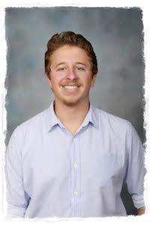
Using the Media to Shine: Platforms and Followers
Presented By:
Shaun Oberholzer
District PI: Club IT Advisor
District Youth: Head of PI and Training

Slide 2
Why do we want to share?
Less administration required than legacy media.
Quick and easy way of letting the public know what your club is doing.
Grow your community following and support.
Simple way to share your clubs activities with friends and family.
Encourage membership growth.
Allow fellow Rotarians in the local/international community to feel more connected and aware of opportunities.
Allow for all members to have the ability to assist with club public image.
Brings a multinational district together.
Easier additions to clubs website.

Slide 3
Available Platforms
A quick overview

Slide 4
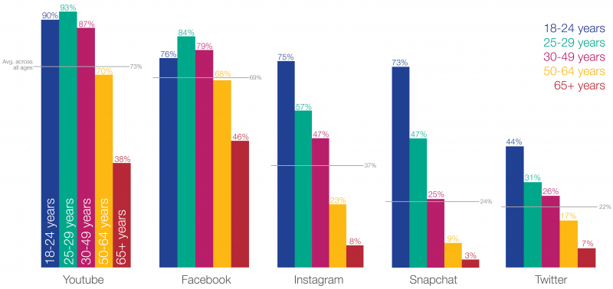
Who is using social media?

Slide 5
Why is making a choice important?
Matching your clubs public identity with social media platforms

Slide 6
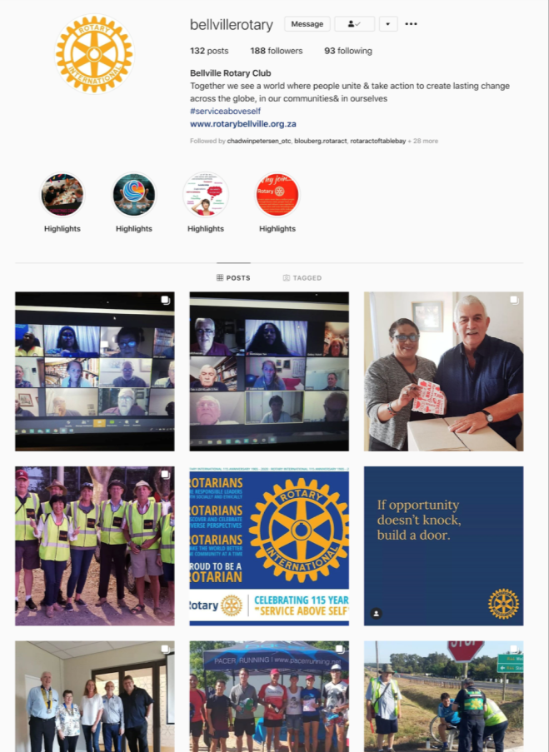
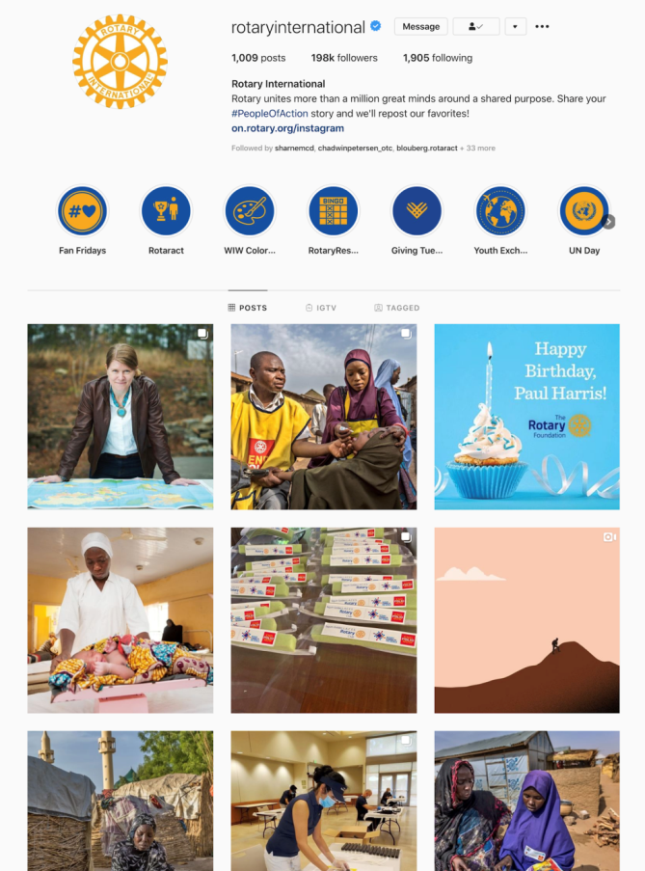
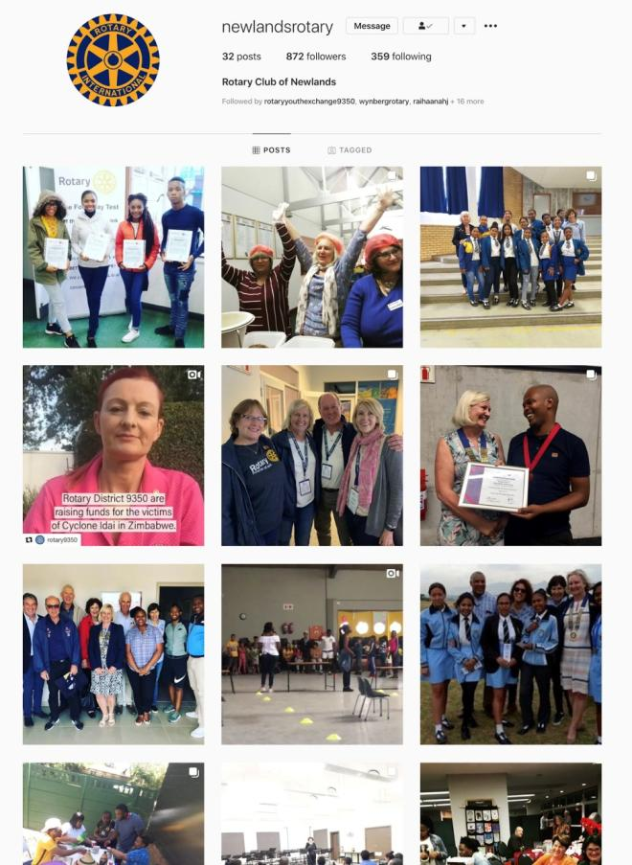
Instagram

Slide 7
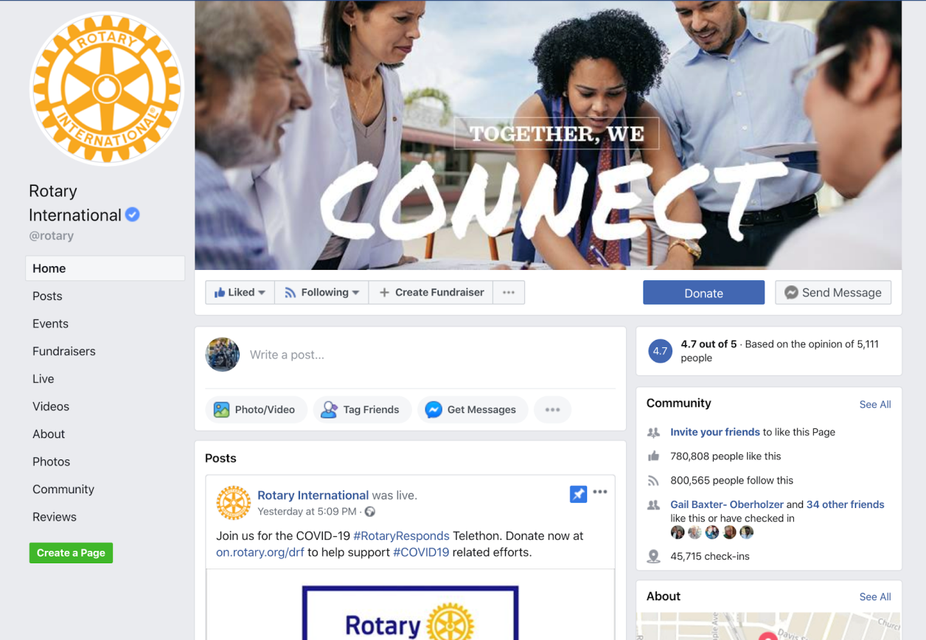
Facebook

Slide 8
What to ask?
How do we get started?
Which platforms are best for my club?
How can this be integrated with our club website?
What training is available for our clubs?
Which other platforms may work for our club?
How can we boost our current social media presence?
How do we get more out of our profiles?
Why is using a Facebook page better than having it set up as a person, and how do we go about making the transition?
What does having more followers mean for our club?

Slide 9
Now to get Discussing and Sharing!
Shaun Oberholzer
ShaunRotary@gmail.com
@ShaunOberholzer

