Slide 1
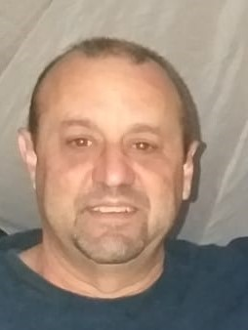
POETS 2020-2021
ROTARY BUSINESS NETWORK Presented by:
AG Carl Bayhack
D9350 Assistant Governor
“NETWORKING IS ESSENTIAL IN THESE TRYING TIMES”

Slide 2
POETS 2020-2021
ROTARY BUSINESS NETWORK
Exclusive Rotarian business network for district 9350
Find a business in district 9350 operated or owned by Rotarians, promoting the ideals of;
“THE FOUR WAY TEST”
www.rotarybusinessnetwork.co.za

Slide 3
POETS 2020-2021
CONCEPT
Rotarians in District 9350 cover a wide range of Professions.
Search for a Rotarian that is in the business that you require.
Have peace of mind, you are dealing with a Rotarian that you can trust.
You are supporting a Rotarian.
Look no further – go to:
www.rotarybusinessnetwork.co.za

Slide 4
POETS 2020-2021
TWO LISTING OPTIONS
BASIC LISTING
Company name,address,contact details and website
PREMIUM LISTING
Company name, business description, address, website, email address, company logo, video and slide images

Slide 5
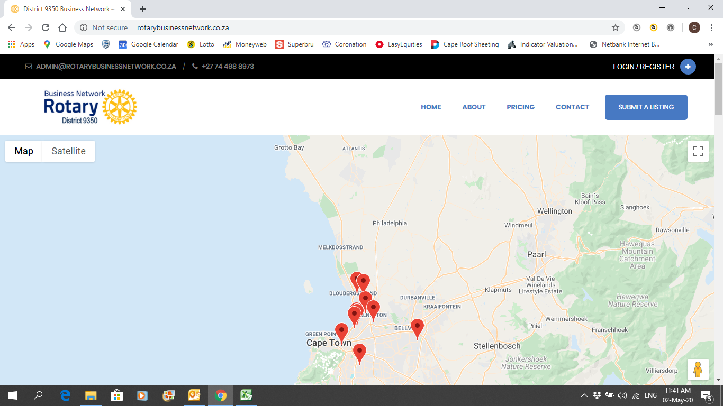
POETS 2020-2021

Slide 6
POETS 2020-2021
WAY FORWARD
Website and back office is done by fellow Rotarian Tonie Konig, all contact details are available on the website.
The goal is to list over 300 Rotarian businesses on the website
Create Search Engine Optimization (SOE)
Zoom meetings to showcase your business, this will enhance knowledge of Rotarian businesses.
Host an annual rotary business network event to showcase your business to other Rotarians.

Slide 7
POETS 2020-2021
PROCESS
Log onto: www.rotarybusinessnetwork.co.za
Click on register and complete
Setup password
Once completed login
Click on submit a listing
Enter all your business details and choose between basic or premium listing

Slide 8
POETS 2020-2021
COSTS
The rates are very favorable and are billed annually.
Payment options will be available to pay online via PayPal or alternatively payment on presentation of invoice.
Basic listing: R246.96 per annum.
Premium listing: R497.04 per annum.

Slide 9
POETS 2020-2021
CONTACT DETAILS
If you need assistance contact us via email.
Carl Bayhack; cjbayhack@gmail.com
Tonie Konig; admin@rotarybusinessnetwork.co.za

Slide 10
POETS 2020-2021
THANK YOU

