Slide 1
WHAT IS RFHA? Rotary Action Group for Family Health & AIDS Prevention
Rotary Action Group recognised by Rotary International … members are Rotarians from across the globe
Mobilizing partner for Rotary International on the second largest disease prevention programme globally after PolioPlus
Governed by 13 Board members based internationally, and engaged with country teams within 8 African countries, Bangladesh and India
Independent NPO/ 501C3 with Global Headquarters in Atlanta, Georgia, USA
RFHA SA NPC is the Southern African entity governing the Strategic Alliance countries
Notes:
Important here:
its size next to Polio Plus
the international representation of the RFHA Inc Board
the role that RFHA SA NPC plays in providing the framework that other countries are emulating.

Slide 2
RFHA OBJECTIVE
To facilitate projects aimed at the improvement of family health and the prevention of HIV and AIDS.
South Africa || Lesotho || Nigeria || Uganda || Ghana || Côte d'Ivoire
Benin || Togo || India || Bangladesh
Notes:
Note the additional countries that host RFHDs … the number is growing and South Africa is leading the way in terms of processes and its engagement with the National Department of Health (NDOH)

Slide 3
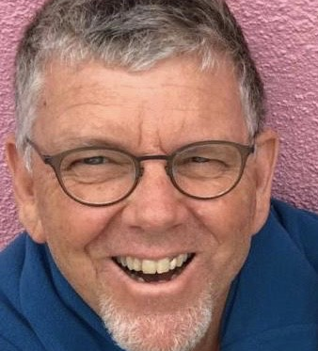
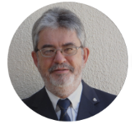
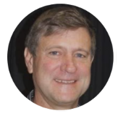
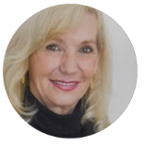
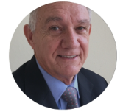
RFHA SA NPC update 2020
Martin Scholtz Rtn: Programme Director
Board of Directors:
PDG Grant Daly, Board Chair (SA D9400)
PDG Anton Meerkotter, Financial Director (SA D9400)
PDG Greg Cryer (SA D9370)
PDG Lynette Stassen (SA D9350)
Notes:
As of 1 February Martin Scholtz joined RFHA NPC as the Programme Director for Southern Africa
RFHA NPC board members are represented by all three districts in Southern Africa: D9400 / D9370 / D9350

Slide 4
Strategic Alignment: Rotary International
Disease Prevention
Maternal & Child Health
Notes:
The program has Strategic Alignment with the World Health Organization’s Sustainable Millennium Development Goals, Rotary International Areas of Focus (Disease Prevention and Maternal & Child Health), and each country’s government’s priorities as identified in their national campaigns and vision plans.

Slide 5
2,524,905
beneficiaries have been offered over 11 million free health services
Notes:
Our progress towards this mission so far is 2 two and a half million people being served across the globe

Slide 6
WHY ARE WE NEEDED:
1,5 MILLION PEOPLE
DIE FROM TB EVERY
YEAR
GLOBALLY
37,9
MILLION PEOPLE ARE LIVING WITH HIV
WORLDWIDE
1 PERSON IS INFECTED WITH HIV EVERY
17 SECONDS
QUADRUPLE
BURDEN OF DISEASE IS CRIPPLING SOUTH AFRICA
AND THE WORLD
2500 YOUNG WOMEN GET HIV EVERY WEEK
IN SOUTH AFRICA
76 PEOPLE DIE EVERY MINUTE
FROM PREVENTABLE DISEASES GLOBALLY
1 IN 50
PEOPLE ARE INFECTED WITH HEPATITIS
B OR C
107,467 SOUTH AFRICANS ARE DIAGNOSED WITH CANCER EACH YEAR
Notes:
Just reflect on why the RFHDs are so important. This is the reality that we face in South Africa and globally.

