Slide 1
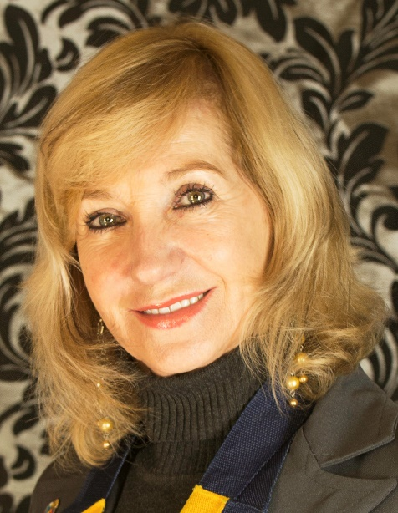
POETS 2020-2021
CLUB BY-LAWS Presented by:
Lynette Stassen
D9350 District Trainer
“What are Club Bylaws?”

Slide 2
POETS 2020-2021
CLUB BYLAWS
What are Club Bylaws?
Part of constitution that sets out
What clubs can do
What clubs cannot do
A Rotary club has 2 constitutional documents
Club Constitution: prescribed text by RI
Club Bylaws: Basic requirements as per RI + amend with own club rules + tax provisions

Slide 3
POETS 2020-2021
CLUB BYLAWS
Why are Club Bylaws important?
New changes from RI regarding club flexibility
Legal power to incorporate the flexible changes
Consider what you want to do
How you want to do it
Draft amendments to the bylaws
Have bylaws approved by your members
Implement!

Slide 4
POETS 2020-2021
CLUB BYLAWS
Example of changes for Club Bylaws
New clause on flexibility to overcome Article 7 Section 1
Method of meeting requires no bylaw change as constitution states
“Attendance may be in person, by telephone, online or through and online interactive activity”.

Slide 5
POETS 2020-2021
CLUB BYLAWS
Attendance at Club meetings
RI prescribed Club Constitution (Article 10) provides meeting alternatives
Article 13 S4 on “termination of membership for non-attendance”
Clubs are allowed to include provisions in their bylaws thar are not in accordance with
Article 10 Section 4 ; and
Article 13 Section 4

Slide 6
POETS 2020-2021
CLUB BYLAWS
Specific example of changes to Club Bylaws
Constitutional attendance requirements was replaced by simple and straightforward provisions.
Focus on participation, not attendance (83% actively involved in 8 months)
Choices are yours (as long as not in conflict with RI Constitution)

Slide 7
POETS 2020-2021
CLUB BYLAWS
Kinds and Types of Membership
Two kinds of membership – active & honorary (as is)
New types of club membership – Session 1 Topic 1
Changes to bylaws for new club membership – take special note of
Corporate
Satellite

Slide 8
POETS 2020-2021
CLUB BYLAWS
Income Tax: an important provision
Provisions for different income tax purposes
Comply with SARS requirements – document provided
Section 1 – 5 same and part of club bylaws
Section 2 – mandatory to include
District Support: Admin Head PDG Peter Hugo

