Slide 1
POETS 2020-2021
PURPOSE of PETS/POETS
PETS: required training for all incoming club presidents
POETS: D9350 added Club Officers to PETS
Purpose of POETS: to combine our District’s efforts and resources to provide the best possible training and preparation for all our District Club Board members.

Slide 2
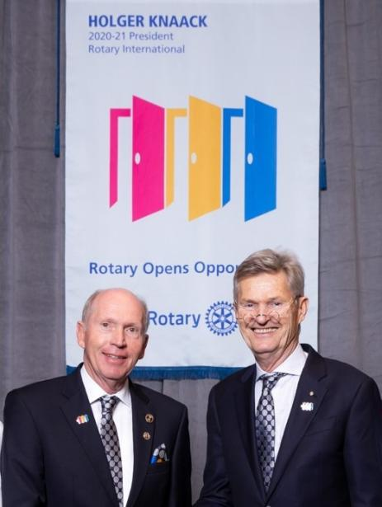
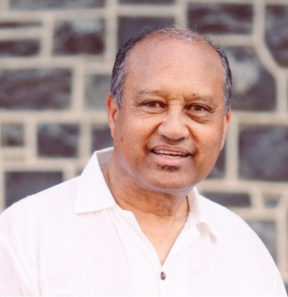
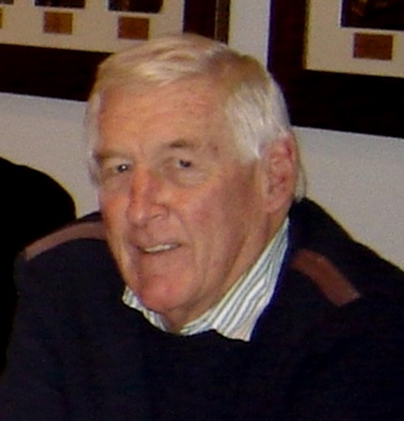
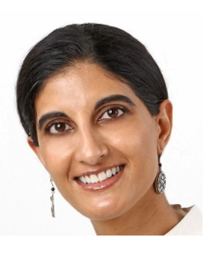
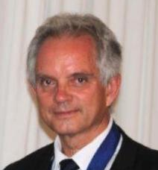
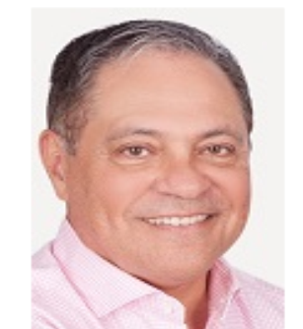
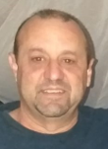
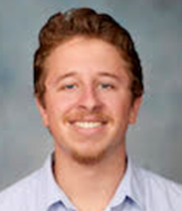
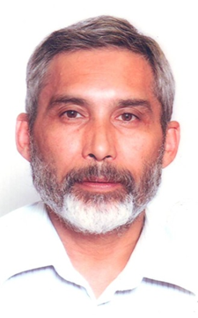
POETS 2020 PRESENTERS

Slide 3
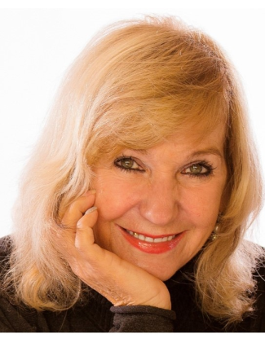
POETS 2020-2021
WELCOME Presented by:
Lynette Stassen
D9350 District Trainer
“Open Opportunities in 2020-2021”

Slide 4
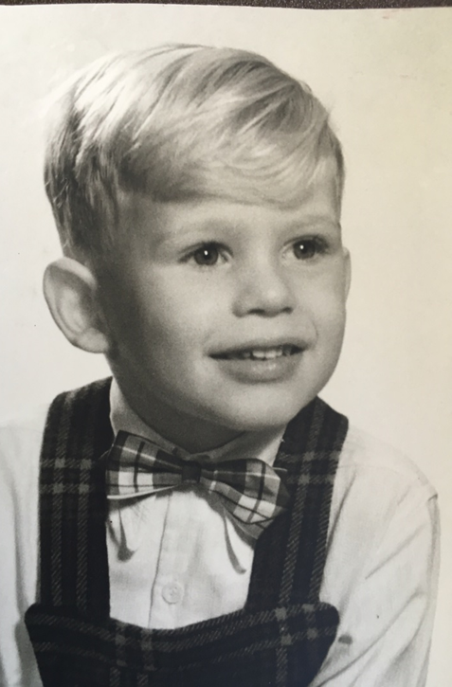
The Story of our
2020-2021 DG‘s Life

Slide 5
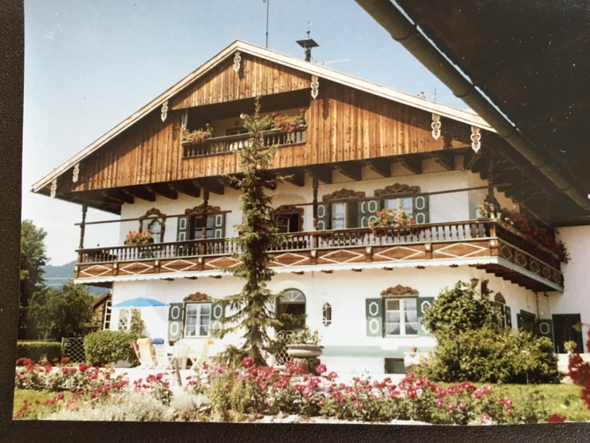
POETS 2020-2021
Life on a farm in Bavaria with hobbies
Entrepreneur
Breeding rabbits (1961-1971)
Sportsman
Soccer
Golf
Table Tennis
Skiing

Slide 6
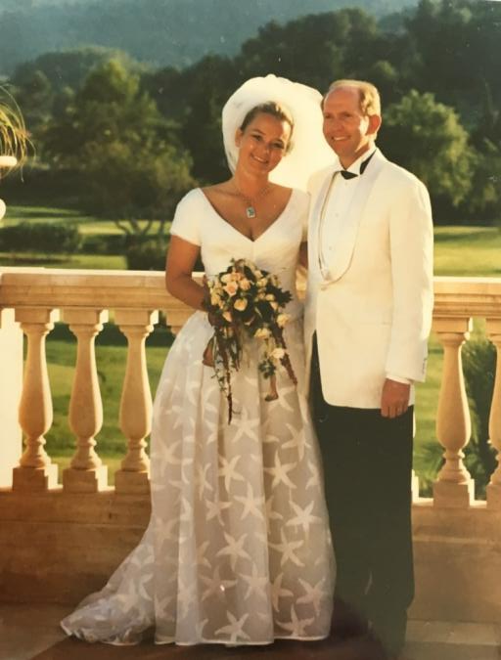
POETS 2020-2021
The Duisberg Family
1971 Matric (ancient Greek, Latin)
1971-1976 Study for First Law Exam
1979 Second Law Exam
1983 Dr of Law
1997 Married to Caroline
2 Children: Carl-Felix and Isabella

Slide 7
POETS 2020-2021
Career Highlights
1983 Admission as a Lawyer
1988-1998 Managing Director of National Center for Environmental Health in Munich
1995-2000 Head of Supervisory Board of Schoerghuber Group of Companies in Munich (SUG)
2000-2004 Deputy Chairman SUG
Chairman of two public listed companies in Germany

Slide 8
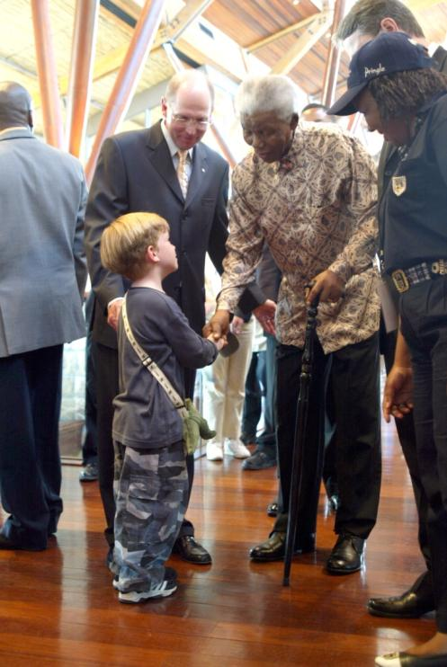
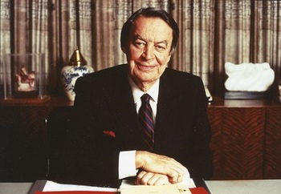
POETS 2020-2021
People who inspired me to immigrate to South Africa

Slide 9
Falling in love with South Africa
1971 First visit
1973 Second visit
1988 Dr Anton Rupert in Munich
1997 fact finding trip to RSA with Mr Schoerghuber
1998 Investment in Arabella Country Estate
1998 Chairman of „Arabella South Africa Holding (Pty) Ltd“
Meeting Madiba twice (2002 and 2003)
2005 Immigration to Somerset West
2005-2009 June 2005 until 2009 (private equity projects)

Slide 10
POETS 2020-2021 Carl-Heinz and Service
1991-2006 Founding member of RC München-Königsplatz
2006 Founding member of HSRC and President 2013/14
2012-2015 D9350 involvement in various committees
2015 - 2019 District Foundation Chair
AND
Member of the Peace Parks Foundation
Patron of “Siyabulela Pre-Primary School” in Kleinmond.
Member of Exec Committee of Child Welfare Kleinmond
Member of the Jury of the Bayer Science & Education Foundation
Board member of the “Carl-Duisberg-Foundation

Slide 11
