Slide 1
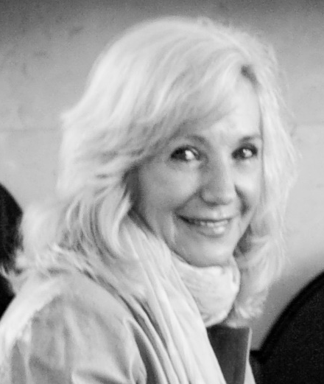
POETS 2020-2021
GROW HEALTHY RELATIONSHIPS Presented by:
Lynette Stassen
D9350 District Trainer
“Expert Antidotes for a Healthy Club”

Slide 2
POETS 2020-2021
Top 10 Expert Antidotes for a Toxic Club Environment
Can you cure a toxic club environment?

Slide 3
POETS 2020-2021
Antidote 1: Acknowledgement

Slide 4
POETS 2020-2021
Antidote 2: Action

Slide 5
POETS 2020-2021
Antidote 3: Communication

Slide 6
POETS 2020-2021
Antidote 4: Fairness

Slide 7
POETS 2020-2021
Antidote 5: Fun

Slide 8
POETS 2020-2021
Antidote 6: Flexibility

Slide 9
POETS 2020-2021
Antidote 7: Socialization

Slide 10
POETS 2020-2021
Antidote 8: Recognition

Slide 11
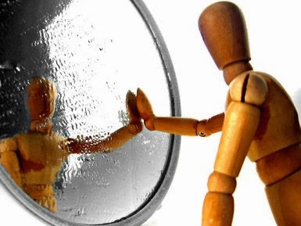
POETS 2020-2021
Antidote 9: Self-reflection

Slide 12
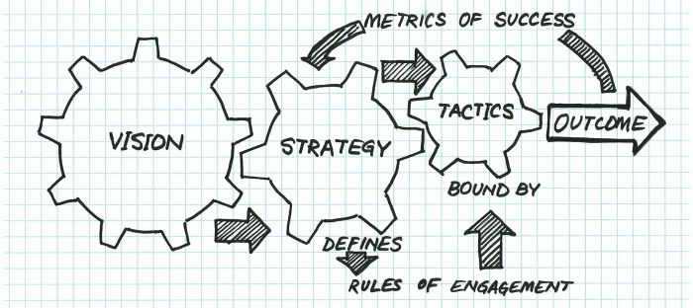
POETS 2020-2021
Antidote 10: Strategy
This Photo by Unknown Author is licensed under CC BY-SA-NC

