Slide 1

Why Attend Rotary
Leadership Institute?
Leadership Development
Rotary Knowledge
Exchange of Ideas
Member Engagement
Service Project Leads
Strategic Planning
Improved Communication
Team Building
Public Relations
International Perspective

Slide 2
How does it work?
Three Classes
  5 to 6 hour sessions
  50-minute segments
Discussion and Participation
  Not Lecture!
Skilled Facilitators
$40 cost per session
  Clubs often subsidize
  Lunch included
Who should attend:
  Future club leaders
  New Members
  Active Rotarians

Slide 3
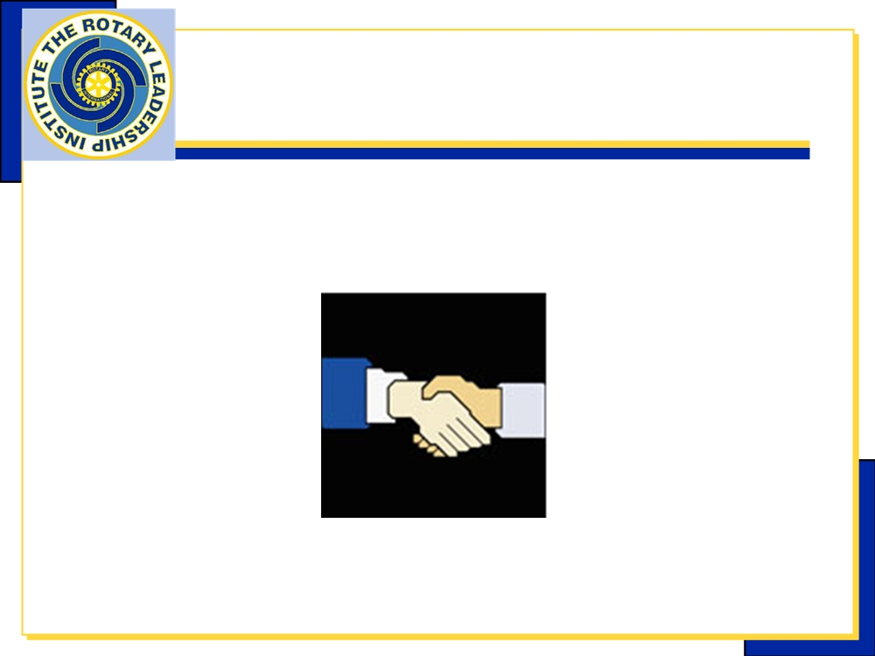
Rotary Leadership Institute
Introduction to RLI
Part I
Rotary Leadership Institute - Part I

Slide 4
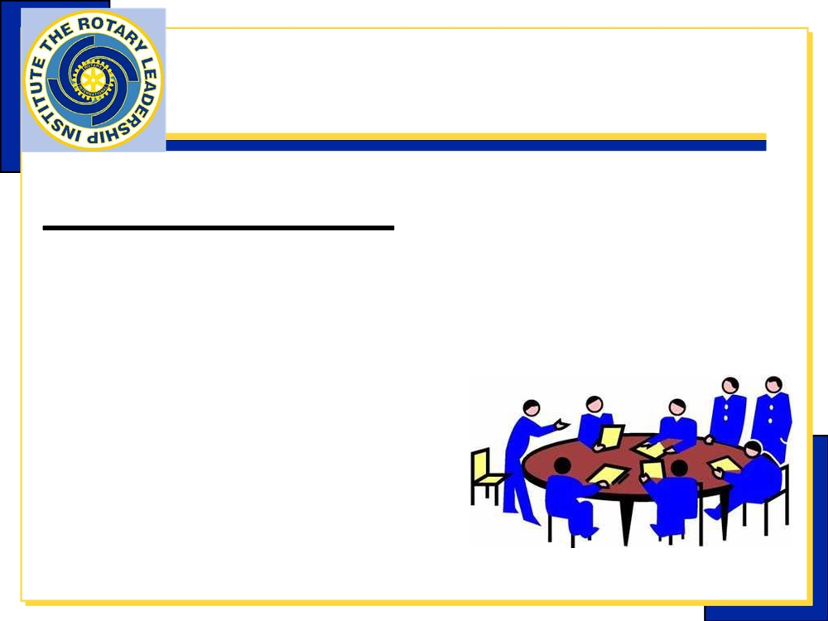
Insights Into Leadership
Goals of the Session
Explore the Characteristics of Leadership
Discuss what Motivates People in a Volunteer or Civic Organization
Examine Your Own Leadership Style
Rotary Leadership Institute - Part I

Slide 5

My Rotary World
Goals of the Session
Discuss the Purpose of
Rotary
Understand the Layers of
Our Organization
How Can People at each Level Help your Club
Rotary Leadership Institute - Part I

Slide 6
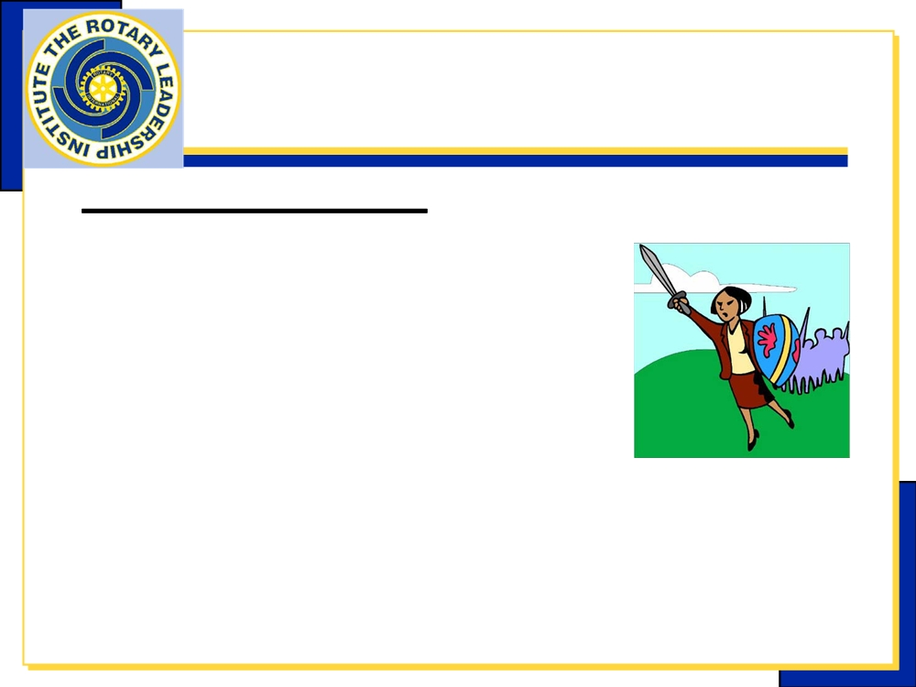
Engaging Members
Goals of the Session
Identify the Value of Engaging Our
Members
Discuss Ways that I can be
Involved in Club Activities
Explore Options for Engagement
Rotary Leadership Institute - Part I

Slide 7

Our Foundation
Goals of the Session
Review the Basic Goals,
Programs & Financing of
our Rotary Foundation
Discuss the Importance & Value of
our Rotary Foundation to Clubs and
to Rotary International
Rotary Leadership Institute - Part I

Slide 8
Ethics – Vocational Service
Goals of the Session
How should the Guiding Principles of Rotary strengthen
me in my vocation?
How can Rotarians promote the 4-Way Test in their community and professional life, in all stages of life?
How can I promote Rotary and Rotary ideals within my vocation?
How do I make my vocation useful to
Rotary?
Rotary Leadership Institute - Part I

Slide 9
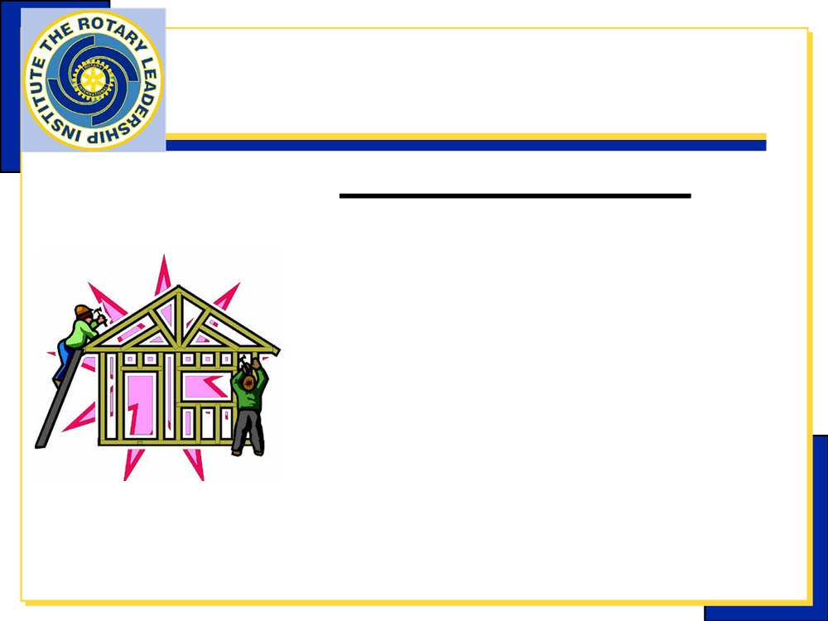
Service Projects
Goals of the Session
How can individual Rotarians, plan, lead and implement a service project in my club?
How can I encourage
creativity and sustainability in
my club’s projects?
Rotary Leadership Institute - Part I

Slide 10
Rotary Leadership Institute
Introduction to RLI
Part II
Rotary Leadership Institute - Part II

Slide 11
Strategic Planning
& Analysis
Goals of the Session
Analyze Your Rotary Club
Review Possible Areas of Improvement
Discuss How to Make Specific Improvements
Understand the Process for Strategic Planning
Rotary Leadership Institute - Part 2

Slide 12
Targeted Service
(Foundation Two)
Goals of the Session
Discuss the importance of
the new grant model to your
club
Discuss the Six Areas of
Focus
Rotary Leadership Institute - Part I
Rev.2006-07-29 bww13 Part 1 - 14

Slide 13
Club Communication
Goals of the Session
Understand the elements of
Effective communication
Apply effective communications
to Rotary leadership
Rotary Leadership Institute - Part II

Slide 14
Team Building
Goals of the Session
Explore How Committees
and Team Building are used
in Rotary Clubs
Discuss the Advantages
and Disadvantages of
Committees
Examine Committees as a
Tool of Leadership
Rotary Leadership Institute - Part II

Slide 15
Attracting Members
Goals of the Session
Identify My Club’s Target
Audience and Profile
Define the Attributes of the
Target Audience
Explore How My Club Can
Attract the Target Audience
Rotary Leadership Institute - Part II

Slide 16
Rotary Leadership Institute
Introduction to RLI
Part III
Rotary Leadership Institute - Part III

Slide 17
International Service
Goals of the Session
How can I, as an individual Rotarian, contribute to International Service?
Exchange ideas supporting why my club should be involved in International Service
What are the benefits of a Rotary Action Group to me?
Explore ideas for International Service projects
Rotary Leadership Institute - Part III

Slide 18
Effective Leadership
Strategies
Goals of the Session
Improve our ability to lead and communicate in group settings
Identify ways we can win support for our goals and proposals?
Rotary Leadership Institute - Part III

Slide 19
Rotary Opportunities
Goals of the Session
Provide an overview of RI’s structured programs
What are the benefits of a Global Networking Group to me?
Discuss each program’s relation to Rotary’s goals and to a Rotarian’s Rotary experience
Rotary Leadership Institute - Part III

Slide 20
Public Image &
Public Relations
Goals of the Session
Discuss Public Image and Publicity as it relates to
Rotary and my Rotary Club
Explore how my club can
benefit from a Public Relations
Strategy
Identify my club’s target
audience and how we can
effectively reach it
Rotary Leadership Institute - Part III

Slide 21
Rotarians, Vocational
Service & Expectations
Goals of the Session
Discuss what Rotary clubs represent to their target
audience in the Vocational Service area when recruiting
new members
Explore how the promise of vocational service affects the attraction and engagement of a club’s target audience
Examine how clubs can offer real value to their members through vocational service
Rotary Leadership Institute - Part III

Slide 22
Making a Difference
Goals of the Session
How can I use the ideas raised at RLI to improve my
Rotary club, other groups in my civic, social or business
life?
How can I, as an RLI Participant,
contribute to improving the RLI
experience for others?
From your experience, analyze the
strengths and weaknesses of the
RLI program, and make some
specific suggestions for improvement
Rotary Leadership Institute - Part III

Slide 23
ROTARY LEADERSHIP INSTITUTE
Fort Collins
8:00 am - 3:00 pm Saturday, November 1, 2014—Courses 1, 2, & 3
Casper
8:00 am - 3:00 pm Saturday, November 15, 2014—Course #1
Helping potential leaders in your club learn about Rotary and leadership!
When You Don’t Know Where THERE is?
  Trained Facilitators will teach leadership skills and expose participants to the larger world of Rotary
  Membership Retention
  International Service
  “Hands-on” Service Projects
  Leading Through Inspiration
  Ideas to Action
Register Now!
GO TO:
District 5440 Website
Rotary5440.org
“District Events”
Only $40 for each course!

